Slide 1
Where to Invest and Where Not
Chris K. Airola
Broker

Slide 2
Disclaimer
Chris K. Airola, California Landlord, Inc. and RentPros Property Management and its affiliates do not provide tax, legal or accounting advice. This material has been prepared for informational purposes only, and is not intended to provide, and should not be relied on for, tax, legal or accounting advice. You should consult your own tax, legal and accounting advisors before engaging in any transaction.

Slide 3
Questions that Make me ☺
Where is the best place to Invest?
Is this a good investment?

Slide 4
Where is the best place to invest?

Slide 5
Property Classes (Neighborhoods)
A Property
B Property
C Property

Slide 6
Class “A”
Newer Homes
Less maintenance
Newer schools & shopping
Higher rents
Class “A” Tenants:
Higher credit scores & income
Tenant screening is generally straightforward
Rent is almost always paid on-time
Tenancy ends with 30-day notice to vacate

Slide 7
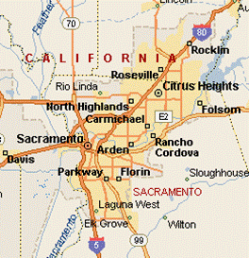

Slide 8
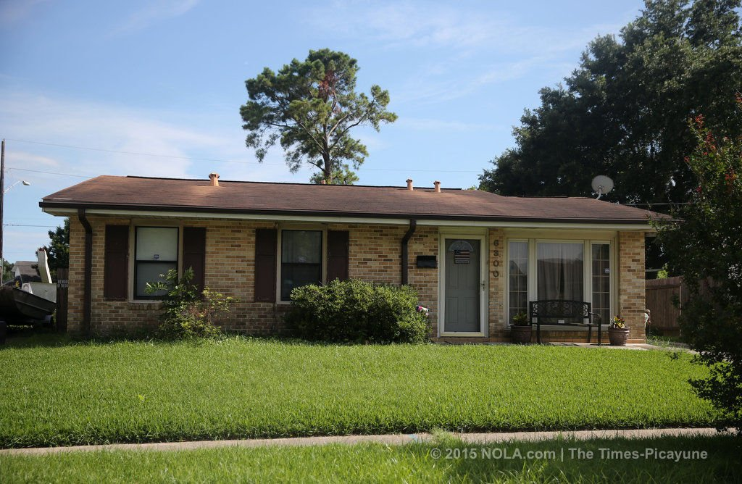
Class “B”
Mixed Age Homes
Moderate maintenance
Class “B” Tenants
Mixed credit scores & income
Tenant Screening is more difficult
Rent is mostly paid on-time
Most tenancy's end with 30-day notice to vacate
Established Schools
Established shopping
Moderate rents

Slide 10
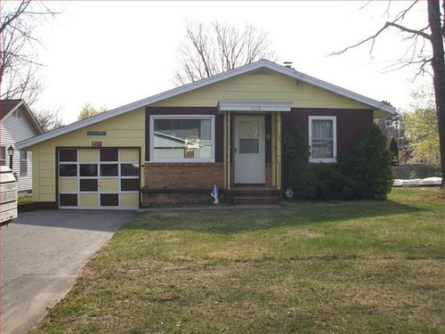
Class “C”
Mostly Older Homes
Regular maintenance required
Class “C” Tenants
Low or no credit score
Older established schools
Limited shopping
Lower rents
Unstable income
Rent is late multiple times per year
Tenancy often ends in abandonment or eviction

Slide 12
North Highlands – Class “C” Area
North
Highlands

Slide 13
Areas within Areas… “A-F” North Highlands – “C” Area
A & B
North Highlands
C
F

Slide 14
Class “F” Properties
Use extreme caution with 4-plexes in 4-plex areas. (Greenback Estates, Roseville Greens, Keon Crest and Sayonara)
Keon Crest, most of Oak Park, Tresler, Renick, most of the Stockton Blvd./Florin area, most of Del Paso North, South portion of North Highlands, Parts of South Natomas

Slide 15
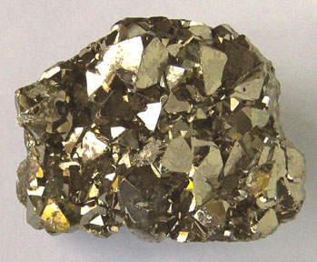
“F” is Fools Gold

Slide 16
How Do You Know For Sure?
Call Local Property Managers
Will You Manage This Property?
Tell me about it….

Slide 17
Investment Buying Rules
Buy A or B Properties in A or B Areas
Be cautious when Buying C Properties in A & B Areas
Do Not Buy C Properties in C Areas
Do Not Buy F Properties Anywhere!

Slide 18
Chris K. Airola
Chris@CaliforniaLandlord.com
(916) 789-3535

