Slide 1
NorCalREIA Investment Club
Established 2004
Celebrating 16 years

Slide 2
We want to thank those men & women have served our country and provided us the Freedom we have today.

Slide 3
Disclaimer:
This information is designed to provide accurate and authoritative information in regard to the subject matter covered. It is offered with the understanding that the presenters are not engaged in rendering legal, accounting, or other professional services. If legal or other expert advice is required, services of a competent professional should be sought.

Slide 4
Our Mission
Educate every level of investor to make calculated decisions and CREATE investment opportunities
Wholesale, Retail Flips and first class Landlord’s
NorCalREIA is your platform to Network with other Real Estate professionals
Notes:
Story about how WIP started off a turnkey rental company, Tom has been syndicating since 2001 when he did his first condo conversion project, however the company took the turn once we learned alternative ways to finance deals, pursuing bigger deals while helping more investors! Sharing his 5 decades of REI experience with YOU!

Slide 6
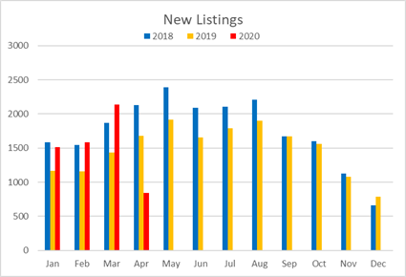
New listings this year was shaping up quite nicely and was consistent with 2018 with number put on. (Remember that we are not quite ½ way through April.)

Slide 9
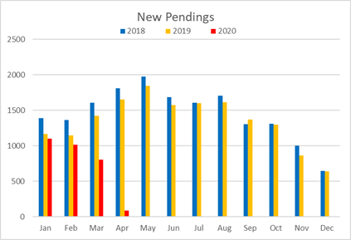
NEW Pendings has declined compared to previous years. (1/2 way through April)

Slide 12
NorCalREIA Investment Club
www.NorCalREIA.com
“Free Resources”
Ryan Lundquist
Joel Wright

Slide 13
Affiliate Appreciation
We want to thank our affiliate’s for your continued support…

Slide 14
Michael Ryan

Slide 15
The #1 Landlord Resource for:
Single-Family Home Rentals, Duplexes, Condominiums, and Small Apartments
Chris Airola
(916) 789-3588

Slide 16
Erin Johansen, CEO
Kayla Aanerud, Housing Manager

Slide 17
Michael Gobbi:
DRE #: 00784661
(916) 601-6224
MikeGobbi@ymail.com
REOs and Investments in Sacramento Area since 1980.
Helping with Out of State Adds to the Portfolio.

Slide 18
Adrian Del Rio

Slide 20
Lorraine D Evans CPA MST Office 916-246-CPA’s (2727)
Cell 808-298-2419 Lorraine@LDEvansCPA.com

Slide 21
SacWholesales.com
916-476-2364
WITH LAUREL SAGEn
SACRAMENTO AREAS MOST TRUSTED WHOLESALE TEAM!
Get our leads FIRST!
JOIN our Buyers List at
www.SacWholesales.com

Slide 22
Rob Gutowsky- V.P. Commercial Loan Officer 916-701-6826 RobertGutowsky@tcbk.com

Slide 24
www.ezmortgages.us
Eric Grathwol
Pain Free Real Estate Financing
916-223-4235

Slide 25
6 day close
Up to 90% of Purchase Price
100% of Rehab
Lien-release capabilities!
Andy Petersen – VP Business Development

Slide 26
Tom Manning
916.995.4931

Slide 27
Juan Deshon
www.QuestTrust.com
855-FUN-IRAS (855-386-4727)

Slide 28
Merton’s Construction
916.365.1451

Slide 29
408.867.1867

Slide 30
George Romonsky Realtor 916.709.3558

Slide 31
I may not make a dent in our homeless problem
I WILL make a difference in someone’s life…
David Granzella ~ 2020

