Slide 1
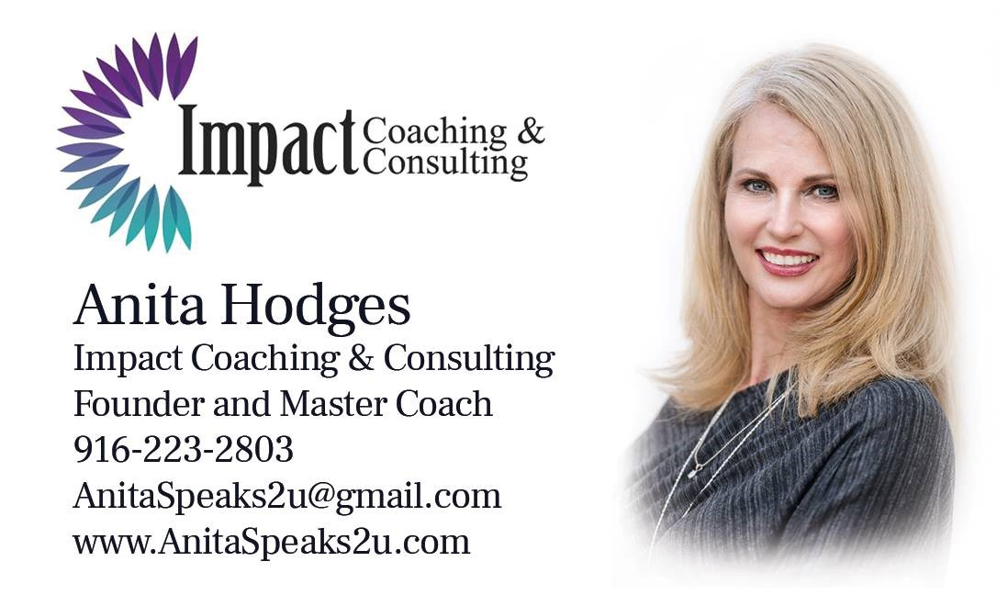
A Life of Purpose and Profit
Bringing Creativity Back

Slide 2
Bolingen Tower

Slide 3
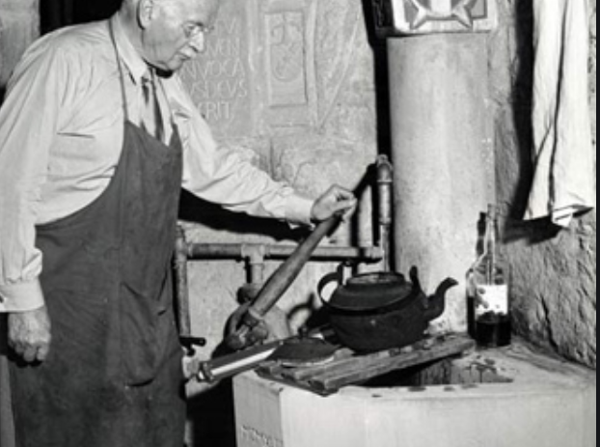
A representation in stone of my innermost thoughts. At Bollingen I am in the midst of my true life, I am most deeply myself”

Slide 4
A Little About Anita
Member of Forbes Coaching Council
Writer for Forbes
Certified Coach and Speaker
Certified Behavioral Consultant
Real Estate Licensee of over 25 years

Slide 5
What You Will Learn
Mind Mapping
SMART Goals
1 – 3 – 5 System
Purpose/Art

Slide 7
What Happened to Imagination?
“The tragedy is that society … keeps drumming the genius part out. ..our culture has engaged in a Faustian bargain, in which we trade our genius and artistry for apparent stability.” ― Seth Godin: Linchpin:

Slide 8
It’s not Either/Or
It’s AND

Slide 9
What is Mind Mapping?
A mind map is a diagram used to visually organize information. It’s a graphic thinking tool that fosters creativity, helps structure information, visualize connections between several ideas.

Slide 10
Benefits
Unleashes Creativity
Improved Memory Retention
Aids Focus
Internalization of Concepts
Can Make One up to 23% More Effective

Slide 11
Can Be Used For:
Planning
Creating
Master Minding
Problem Solving

Slide 20
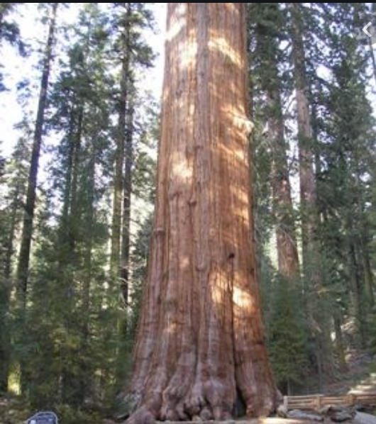
Start with the trunk
What will you be mind mapping today?
An Event?
A Plan?
A Problem?
A Speech?
Your Year?
A Goal?
A Project?

Slide 21
Add the Limbs Categories Ideas

Slide 22
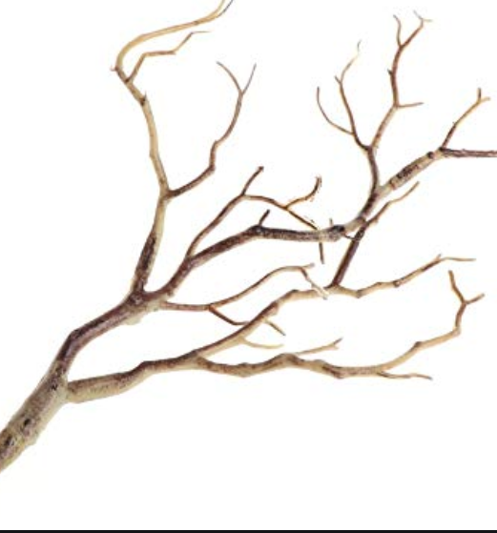
Taking it Further
Details
Possibilities
Questions
Obstacles

Slide 23
DON’T
Think
Over think it
Edit
Edit while you create
Perfection
Feel like you need to be good at it
Fear
Be afraid of getting it “wrong”

Slide 24
Use Art to Anchor
Pictures over Words
Accentuate with:
Pictures
Color
Thickness

Slide 25
Creating a SMART Plan for 2020
Specific
Measurable
Action Oriented
Realistic
Time Bound

Slide 26
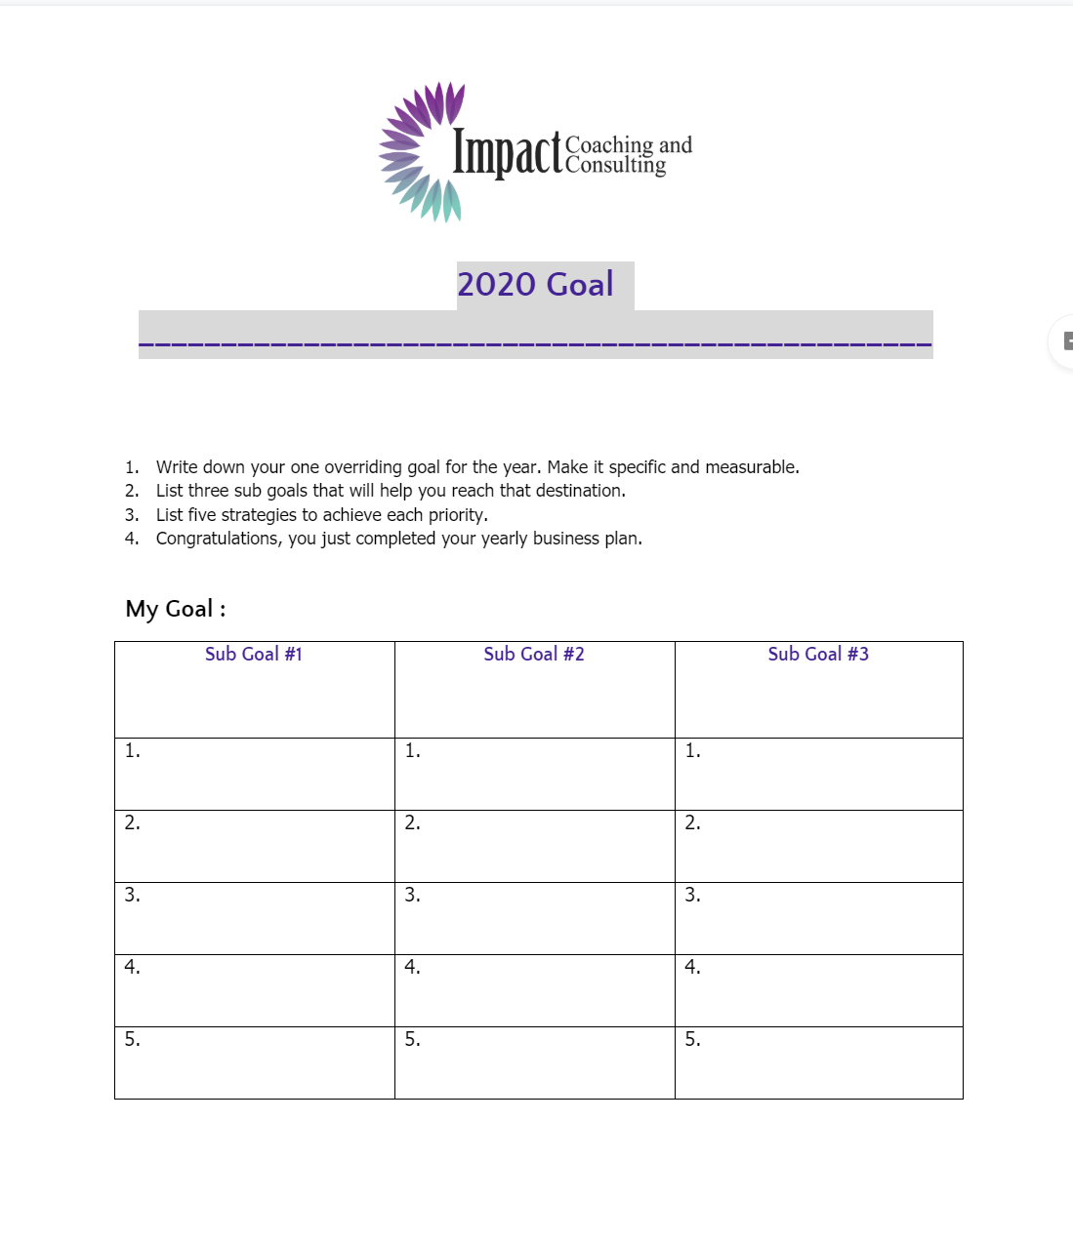
1 - 3 - 5
1 Goal
3 Sub Goals
5 Action Plans

Slide 27
Holding it all Together
Monthly Project
Weekly Goal
Daily Goals

Slide 28
Purpose and the Long Con
It Has to Look Like a Certain Way
It Has to be Massive
It’s About Legacy

Slide 29
What is Art? (And how does it relate to Purpose?)
Art is the representation or replication of something meaningful or beautiful.

Slide 30
Purpose and Work as Art
My Work is an Extension of my Art
My Experiences are Art
My Choices are Art

