Slide 1

David Granzella
founder NorCalREIA Investment Club
Established 2004

Slide 2
Celebrating 15 years
Sacramento, California
Second Wednesday

Slide 3
Disclaimer:
This information is designed to provide accurate and authoritative information in regard to the subject matter covered. This presentation is for education and is offered with the understanding that the presenters are not engaged in rendering legal, accounting, or other professional services. If legal or other expert advice is required, services of a competent professional should be sought.

Slide 4
www.NorCalREIA.com
“Free Resources”

Slide 5
We want to thank those men & women have served our country and provided us the Freedom we have today.

Slide 6
Who am I?
Sales and marketing professional.
Sales for large corporations. Including the second largest pant manufacture in the world. Laid off December 15, 1989. #1
September 14, 2011. #2
Enough is enough.
John M. @ the theater.

Slide 7
October 1, 2002
To: Betty & Chris @ Sacramento Professional Network
From: David Granzella
Well I am making a job a job / career.
I am sick and tired of being sick and tired, being at the mercy of an employer.
I am building a property investment company, with some partners in crime who also want to be their own boss, while possibly having some control over our own lives. I was laid off at 35 & 45, and I have no intention of being laid off again at 55. So we will see what Gods will is for me and if I can stay out of the way.
Thanks one and all for your help and support.
David Granzella

Slide 8

Freedom from…

Slide 9

John Schaub, Peter Fortunato, Walter Wofford, Quincy and Nathan Long, Tom Wilson, Bruce and Aaron Norris, Jack Miller, Jim Harris, Jack Shea, Dyches Boddiford, Dave Wilson, Sean O’Toole, Doug Duncan and a host of other valued relationships…

Slide 10
How did I start?
Was born into a family given a trust fund
Was NOT born into a family and given a trust fund
Started out with $24,000 for investment
Pursued education and knowledge
Drove to the Bay Area several times a month
Steven was 15. Poor planning. Great stories decades later.
Showed up early set up chairs and helped
Stayed late put chairs away. Drove home 2 - 3 hours.

Slide 11
How did I stay in the game?
Built granite retaining walls 6am -2pm. Paid the mortgage.
Drove a limo…
Drove friends and neighbors to S.F. airport. Clients not on purpose.
Long drive. Very long…
Ego is an interesting emotion.

Slide 12
What were my two most important assets?
Faith
Hope
Driven by determination to have control over my life.
I knew what I wanted most in my life…
Do YOU?

Slide 13

Freedom to…

Slide 14
My Tool Box
&
My Team

Slide 15
Tax Avoidance
Tax Benefits

Slide 16
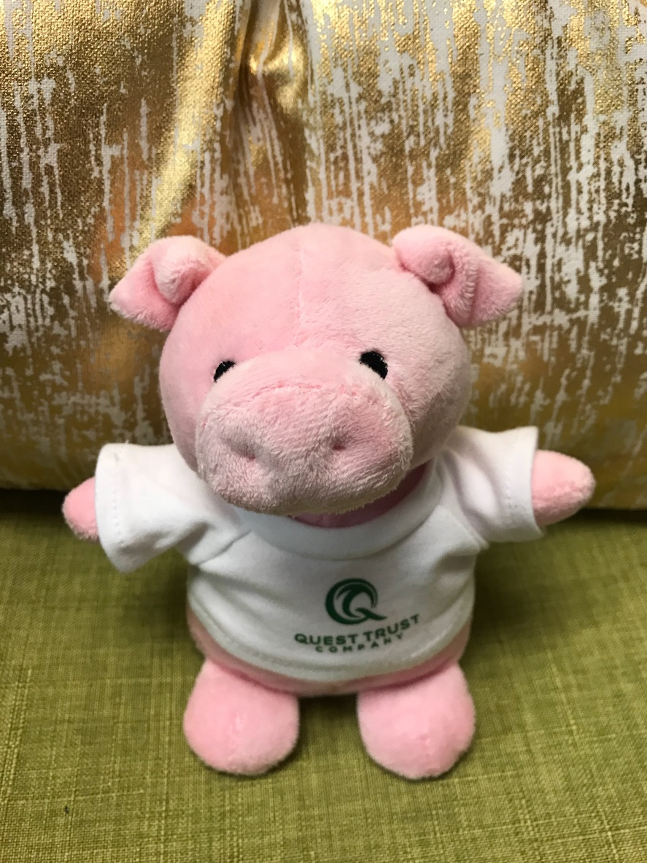
Learn to maximize thi$ tool!
Sharpest knife in the tool box…

Slide 17
Education – Information – Pertinent Data

Slide 18

www.isurvivedrealestate.com

Slide 19
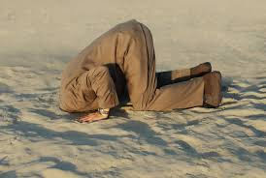
My favorite landlord. No problem here Shirley.

Slide 20



Jay’s Teaching Model
6 Properties, 40 Units
Simple
This Could
Be You!
Property 1
Property 2
Location 6
Property 3
Jay
Property 5
Property 4

Slide 21

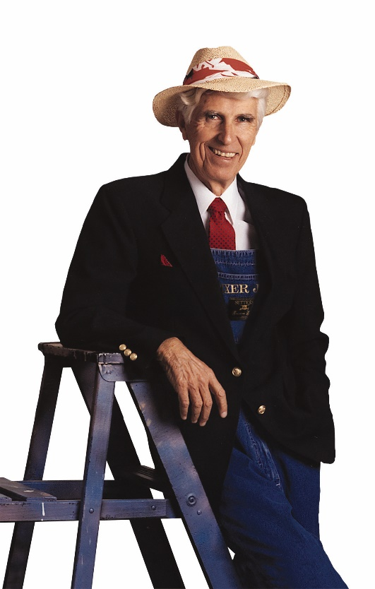
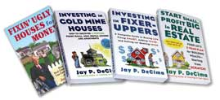

“Fixer Jay”
Jay P. DeCima fixerjay.com

Slide 22

“Are your Ducks in a Row?”
Create a plan of WHY and What your going to do to acquire Rental properties
*Review your existing Portfolio and ask yourself are you ready to hold onto a property for the next 3-5 years or longer? If not, get it ready to sell and exchange it into a higher quality asset.
Make the repairs and capital improvements to your properties NOW!
Get your Rent Rolls, P&Ls, Tax Returns ready to send out to Bankers and Investors.
Are you leaving any income on table or is there potential to increase on your existing portfolio?

Slide 23
Tax Avoidance
Tax Benefits

Slide 24
Leverage
Depreciation
Accelerated Depreciation
Cost Segregation
Seller Financing – Acquisition - going in
Seller Financing – Ender – going out

Slide 25
(There are) No Stupid Questions
    I’ve asked or wanted to ask every dumb question (including “what's ARV?”).
    To this day there is always so much to learn …
    Please, save your questions to the end as they may be answered.

Slide 26
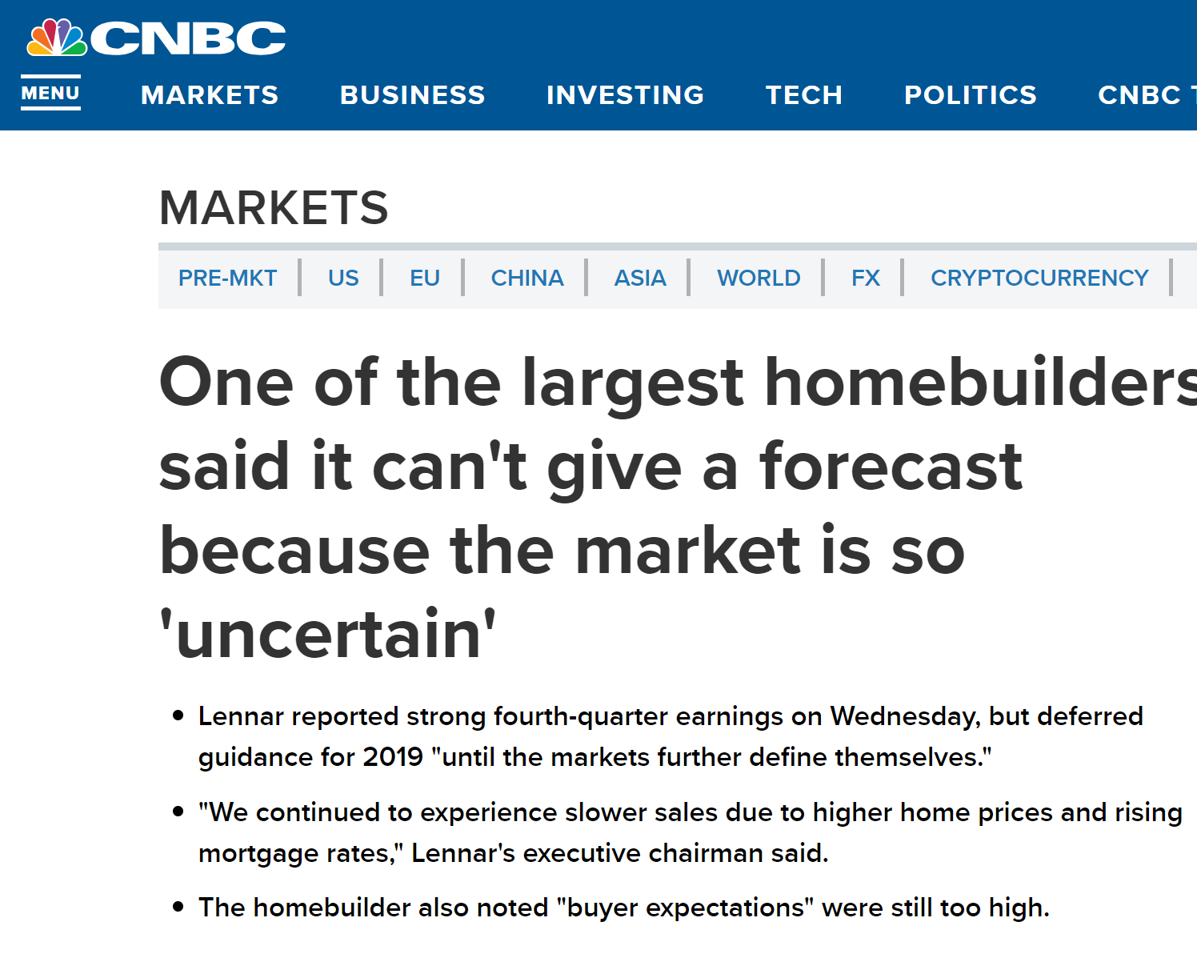

Slide 27


Slide 28
I am buying, holding & renting

Slide 29
Successful Adventures in Multi-Family
Multi-family Investing
Find your niche (5-16 units)
Create & own your farm area
Learn how create deals… (rarely found)
Know how to buy them…
Creating forced equity …
Learn how to run it as a business
Create homes for good tenants…
Create an ATM machine at the end of your driveway

Slide 30
Successful Adventures in Multi-Family
Multi-family Investing
Find your niche (5-16 units)

Slide 31
Successful Adventures in Multi-Family
Multi-family Investing
Create & own your farm area

Slide 32


Slide 33
ProprtyRadar
“Keep your eyes wide open in 2019 with PropertyRadar as they aim to launch Nationally in 2019.”

Slide 34
Successful Adventures in Multi-Family
Multi-family Investing
Learn how create deals… (rarely found)

Slide 35
Creating Opportunities
  Talk to everyone … Door Knocking !!!!!
  Especially owners
  Remember “people” sell properties
  When a person owns it free and clear and does not want to give up cash flow. Though it may not be much. Due to property condition. Educate them on a seller carry back loan. No toilets, tenants, repairs (blue tarp) or property tax's. They can sell, now. Put the duck tape and plunger away.
  And when you hear, “I really want to get rid of this” just smile…

Slide 36
Successful Adventures in Multi-Family
Multi-family Investing
Know how to buy them…

Slide 37
Rentals
Look for minimum of 1.5% rule or GRM 5.5
If building: $100,000, Rents: $1,500
If building: $500,000, Rents: $7,500
This building: $1,000,000, Rents: $15,000

Slide 38
Successful Adventures in Multi-Family
Multi-family Investing
Creating forced equity …

Slide 39
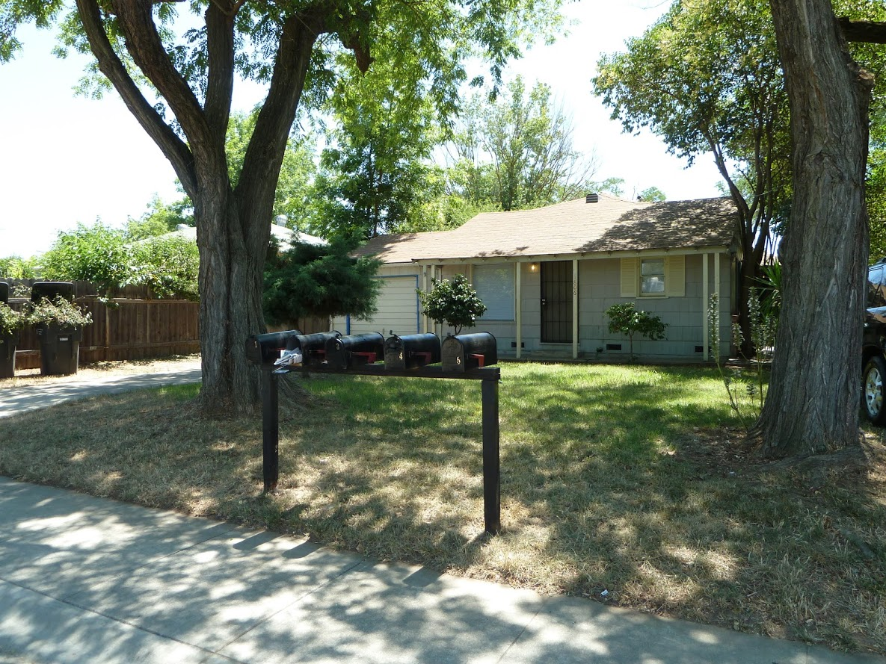
Rental

Slide 40
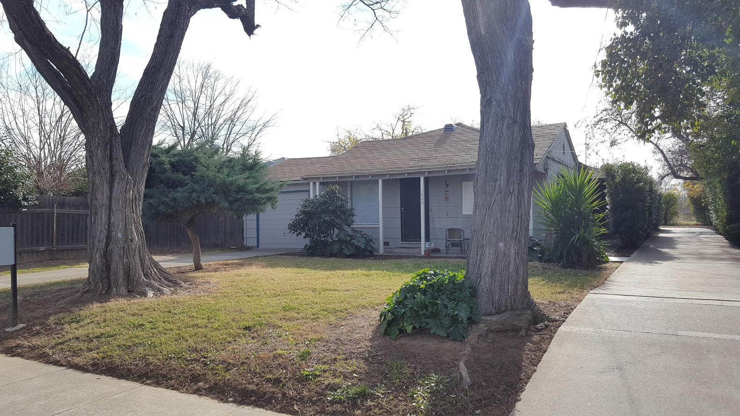
Home!

Slide 41

Take the Next Step
Take the next step in purchasing a property
Take the next step in getting a property your selling ready to go to market
Meet with your lenders, investors, partners to discuss your plans going forward
Start marketing, calling, following up
Write an offer
Accept an offer and 1031 Exchange
Read a book on your focus
Meet with Mentors and ask lots of questions

Slide 42
Successful Adventures in Multi-Family
Multi-family Investing
Learn to run it like a business

Slide 43
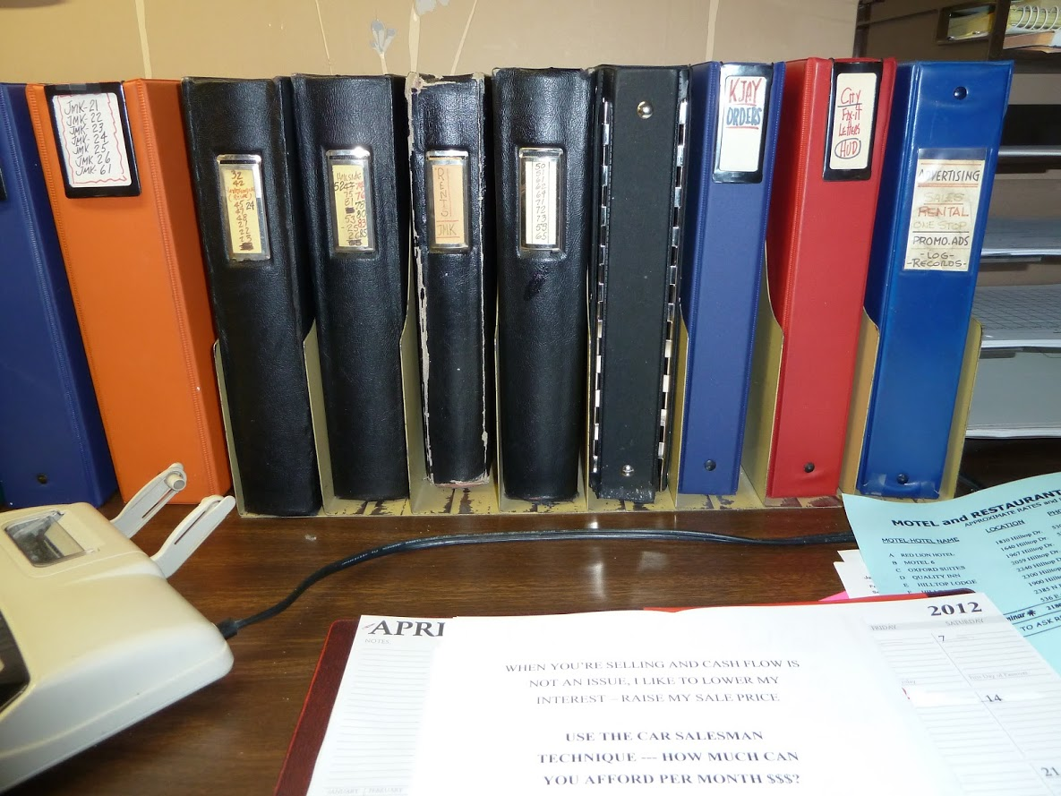

Slide 44
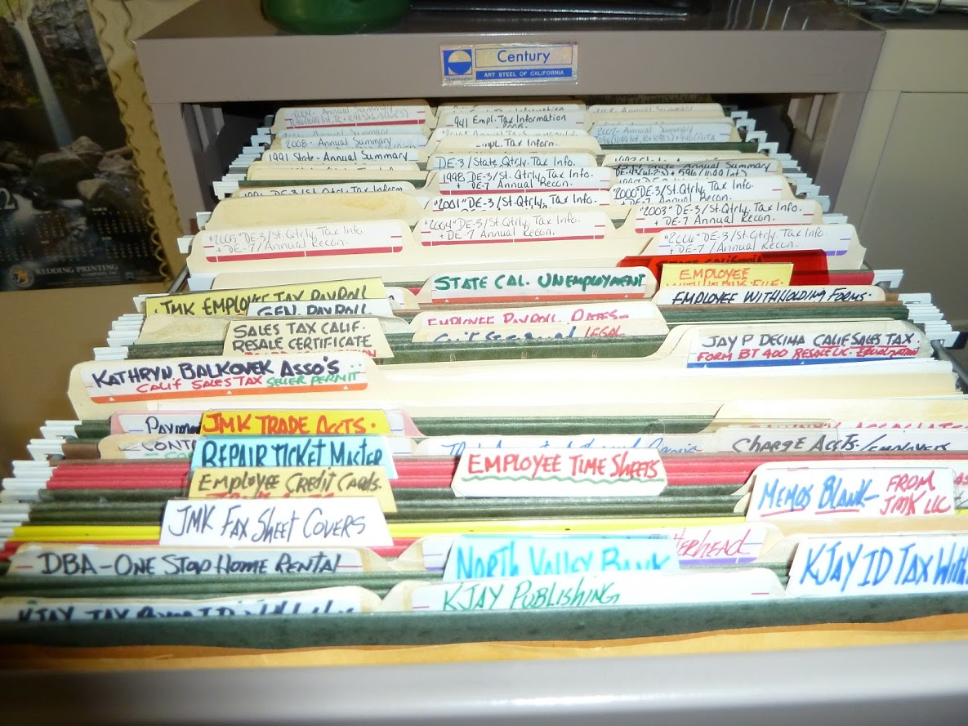

Slide 45
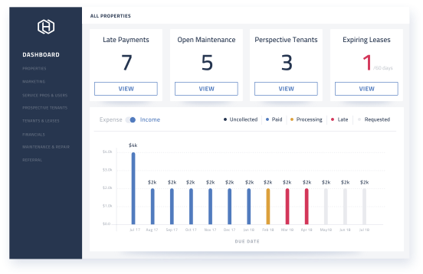
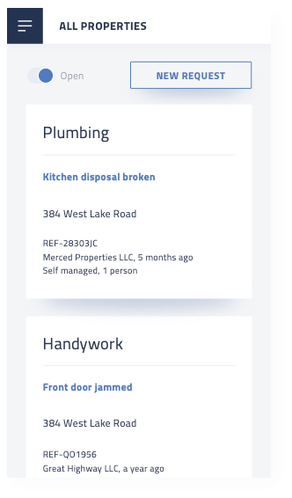
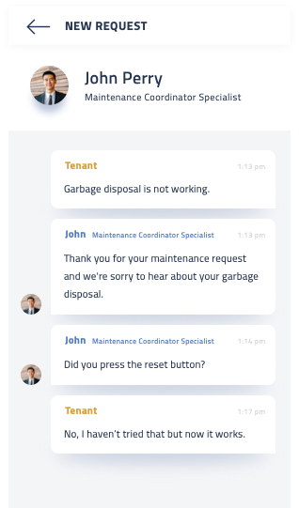
Hemlane
5 star reviews on Capterra & GetApp
Leasing & Management Tools
Maintenance Coordinators & Agents
Day-to-day operational tools in an easy to use interface
US-based for repair requests and agents for showings
www.hemlane.com
Hemlane - confidential

Slide 46
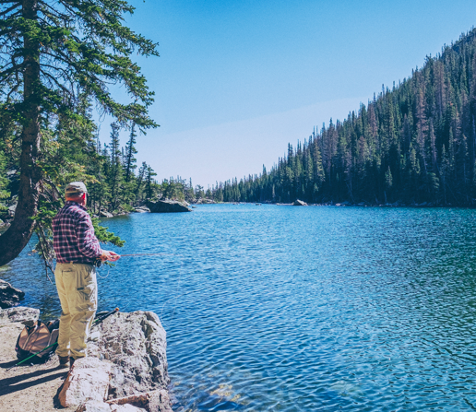

Do what you want.
Live where you want.
www.hemlane.com
Hemlane - confidential

Slide 47
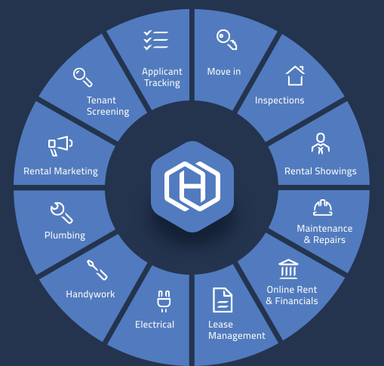
Hemlane
www.hemlane.com
Leasing
Tools
Local
Agents
Maintenance
Coordinators
Management
Tools
5-out-of-5 star reviews on Capterra and GetApp
Hemlane - confidential

Slide 48
Successful Adventures in Multi-Family
Multi-family Investing
Creating a long term tenant…
Create homes for our tenants…

Slide 49
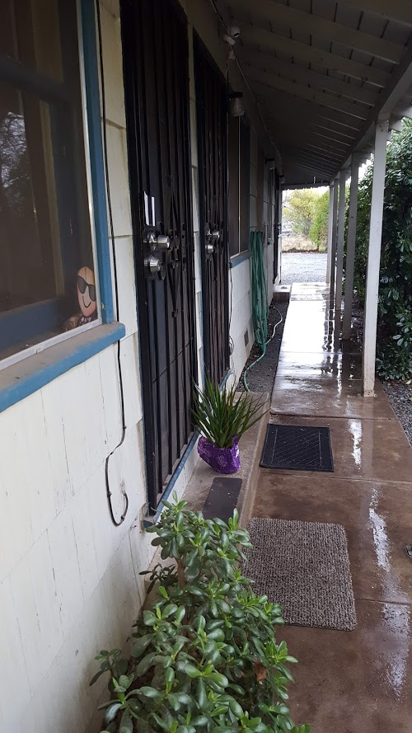
January 2019
Daisy Drive Community

Slide 50
End Game
  As an “ender” we become the bank.
  Monthly income
  OMG, NO tenants, toilets and property tax's
  Paying tax's on the income we receive
  ATM at the end of your driveway

Slide 51

End Game!

Slide 52
“If you want to live a happy life, tie it to a goal, not to people or objects.” A. Einstein
Multi Unit acquisition is already a BHAG
Details of your goal:
Motivation
Actions needed to accomplish this goal
Specific steps to accomplish
Picture these units rented and with “your” tenants
Daily actions
TRACK YOUR ACTIONS, YOUR STEPS AND SUCCESS STREAKS
Talk to:
Don’t wanter’s
Not being well managed

