Slide 1
Wilson Investment Properties
Highest Cash Flow Quality Turnkey Investments in the USA
To Flip or Not to Flip?
NorCalREIA April 9, 2014
Tom K. Wilson
President / Founder
Wilson Investment Properties
Saratoga, CA
408-867-1867
tomkwilson@earthlink.net
www.tomwilsonproperties.com

Slide 2
Dr. Doug Duncan
VP & Chief Economist Fannie Mae
“If anyone tells you that they know how this market is going to play out, run like heck!”
www.tomwilsonproperties.com

Slide 3
“A crisis is a terrible
thing to waste.”
Paul Romer, Senior Fellow at Stanford University
www.tomwilsonproperties.com

Slide 4
Wilson Investment Properties
Agenda
Flipping Status
Flipping Fundamentals
The Market
Flip Examples
Tom’s Do’s and Don’ts
www.tomwilsonproperties.com

Slide 5
Wilson Investment Properties
www.tomwilsonproperties.com

Slide 6
Wilson Investment Properties
So, you want to flip?!
2013 Stats:
156,000 flips in the U.S.
2,100 flips in Sacramento
2,057 San Francisco Flips
745 South Bay flips
www.tomwilsonproperties.com

Slide 7
Wilson Investment Properties
Flipping Facts 2013
4.6% of all houses sold were flips
$58,000 average gross profit in the U.S.
$156,000 average gross profit in the Bay Area
$162,000 average gross profit in the South Bay
www.tomwilsonproperties.com

Slide 8
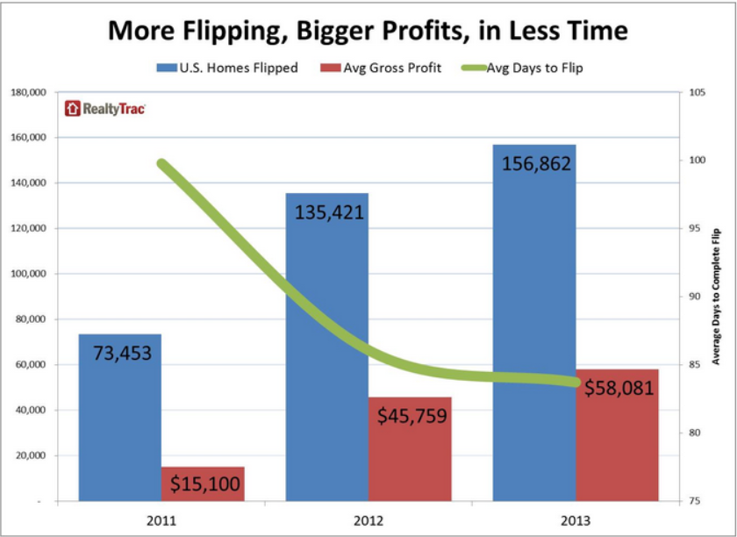
Wilson Investment Properties
Flipping Averages
www.tomwilsonproperties.com
Notes:
8

Slide 9
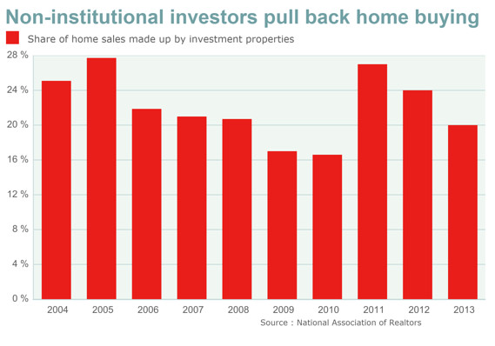
Wilson Investment Properties

Slide 10
Wilson Investment Properties
Flips vs. Buy & Holds
www.tomwilsonproperties.com
Notes:
10

Slide 11
Wilson Investment Properties
Flipping vs. Long Term Holds
Flipping
Active business; time & labor intensive
High risk
Highest taxes
Potential fast returns
Long Term Hold
Passive, mailbox money (almost)
Cash flow & appreciation
Low risk
Low to $0 taxes
Get rich slowly
www.tomwilsonproperties.com

Slide 12
Wilson Investment Properties
Flipping Basics
Have a plan – target, don’t shot gun
Education
Define region
Product
Level of added value
Price range
Financial objectives
Time frame
Line up financing
Get team
www.tomwilsonproperties.com

Slide 13
Wilson Investment Properties
Flipping Levels
Wholesale with assignment contract
Wholesale with purchase & resale
Cosmetic added value
Structural added value
Added value with addition
High end added value full renovation
Scraper with new build (spec)
www.tomwilsonproperties.com

Slide 14
Wilson Investment Properties
Flip Inventory Challenge
REO release rates still low
Market demand high & competitive
Pent up owner occupant demand
Owner occupant buyer priority
Foreclosure & bankruptcy forgiveness
Hedge funds
Increased # of flippers
New flippers overpaying
Flippers counting on appreciation
www.tomwilsonproperties.com

Slide 15
Wilson Investment Properties
High-End Flip Requirements
Exceptional Curb Appeal
Dramatic Architecture but not Eccentric
Great Open Floor plan
Volume (cathedral or high ceilings)
Totally Updated
High Quality Consistent Finish Throughout
www.tomwilsonproperties.com

Slide 16
Wilson Investment Properties
Financing Methods
Subject-To Assumptions
Cash
Hard Money Loans
Private Loans
Equity Share
www.tomwilsonproperties.com

Slide 17
Wilson Investment Properties
Low Inventory Solutions
Less marketed sources
Wholesalers
Bird Doggers
Auctions
Hedge fund overlooks & rejects
Higher end products
Higher added value products
New construction
www.tomwilsonproperties.com

Slide 18
Wilson Investment Properties
Months of Unsold Inventory
www.tomwilsonproperties.com
Notes:
18

Slide 19
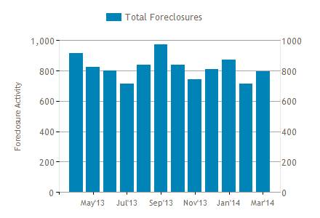
Wilson Investment Properties
Foreclosure Activity for Sacramento County
www.tomwilsonproperties.com
Notes:
19

Slide 20
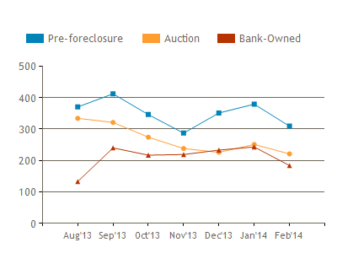
Wilson Investment Properties
Foreclosure Filings in Sacramento County
www.tomwilsonproperties.com
Notes:
20

Slide 21
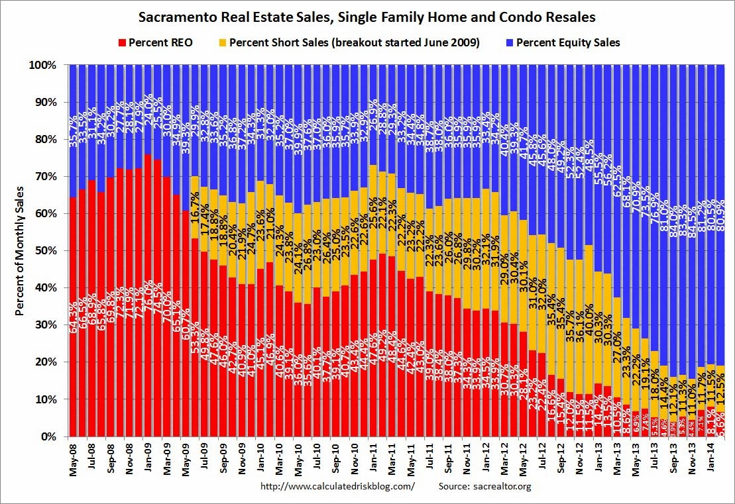
Wilson Investment Properties
www.tomwilsonproperties.com
Notes:
21

Slide 22
Wilson Investment Properties
Months Supply of Homes
www.tomwilsonproperties.com
Notes:
22

Slide 23
Wilson Investment Properties
Low Inventory Solutions
Less marketed sources
Wholesalers
Bird Doggers
Auctions;
Hedge fund overlooks & rejects
Higher end products
Higher added value products
New construction
www.tomwilsonproperties.com

Slide 24
Wilson Investment Properties
The Market
www.tomwilsonproperties.com
Notes:
24

Slide 25
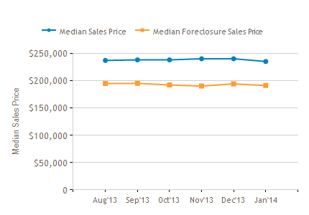
Wilson Investment Properties
Sales Prices in Sacramento County
www.tomwilsonproperties.com
Notes:
25

Slide 26
Wilson Investment Properties
CA vs US Median Prices
www.tomwilsonproperties.com
Notes:
26

Slide 27
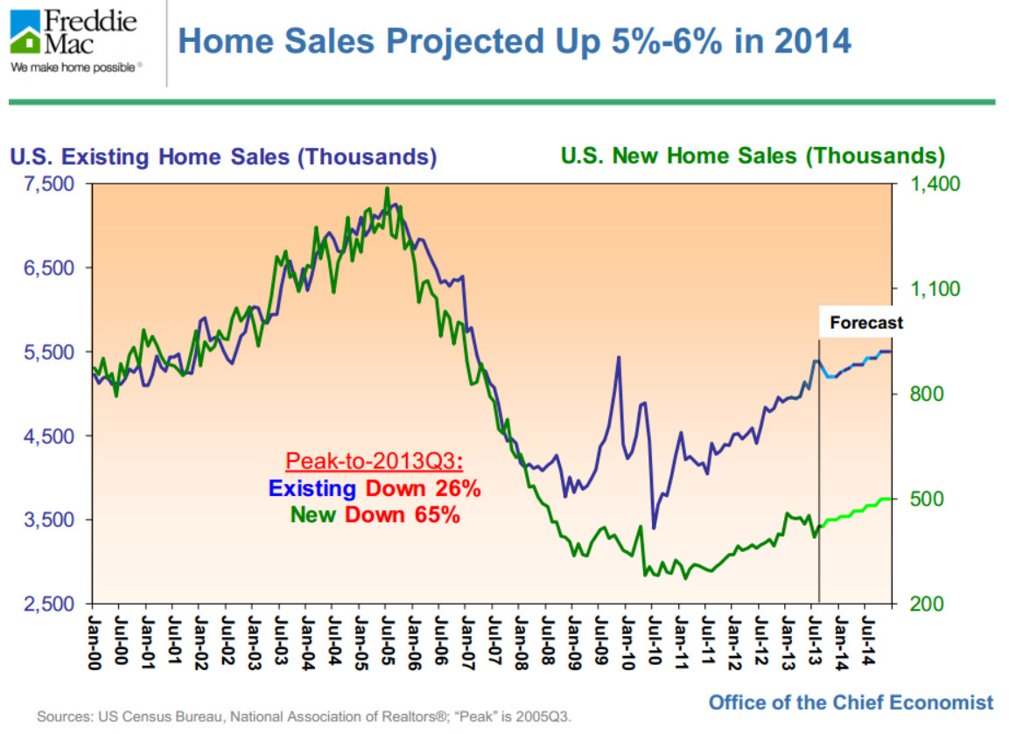
Wilson Investment Properties
2014 Home Sales
www.tomwilsonproperties.com
Notes:
27

Slide 28
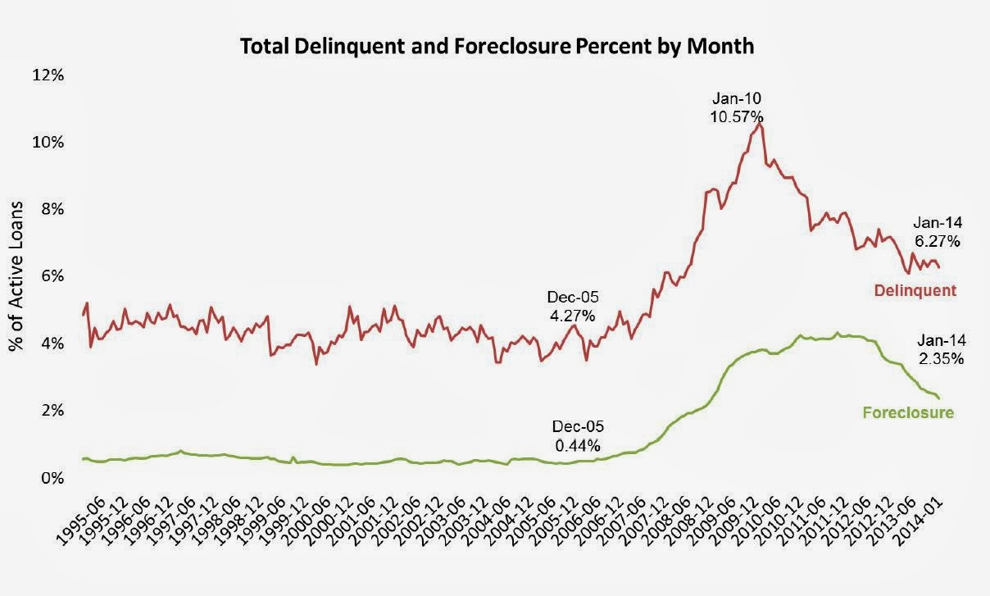
Wilson Investment Properties
Delinquent & Foreclosure %
www.tomwilsonproperties.com
Notes:
28

Slide 29
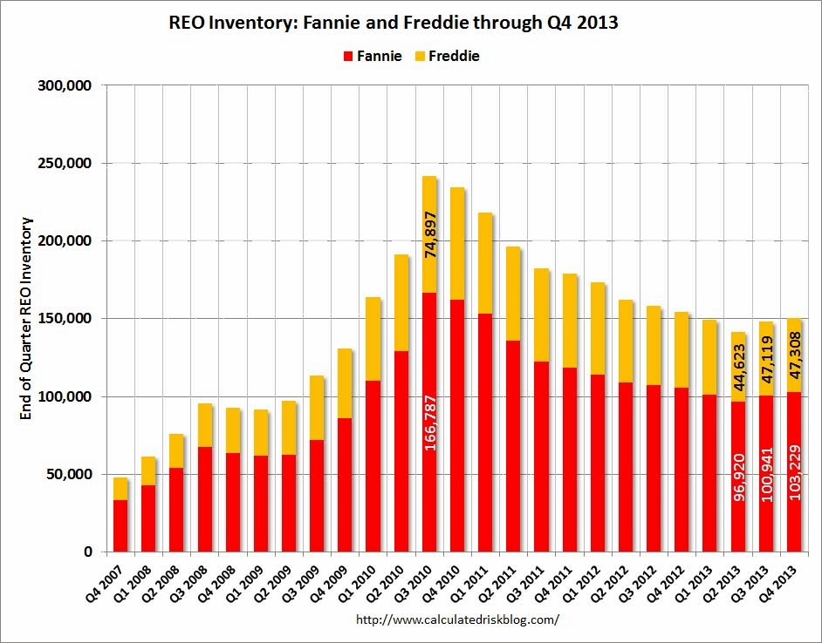
Wilson Investment Properties
REO Inventory
www.tomwilsonproperties.com
Notes:
29

Slide 30
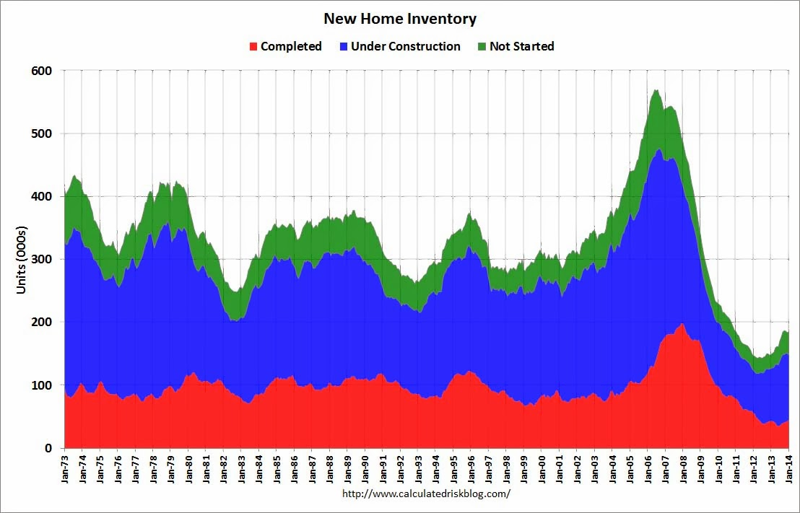
Wilson Investment Properties
New Home Inventory
www.tomwilsonproperties.com
Notes:
30

Slide 31
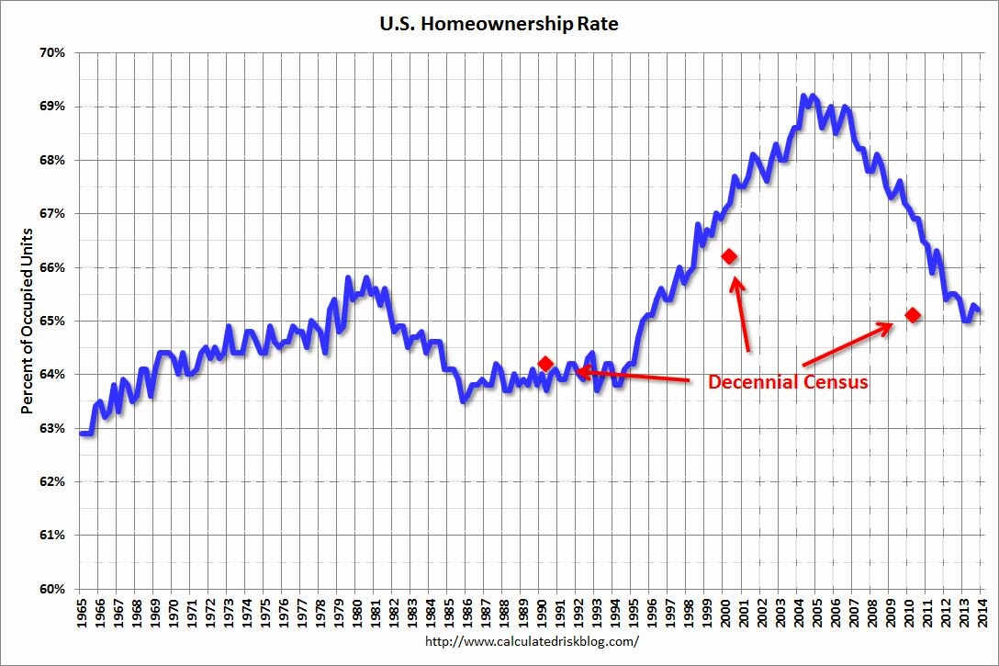
Wilson Investment Properties
US Homeownership Rate
www.tomwilsonproperties.com
Notes:
31

Slide 32
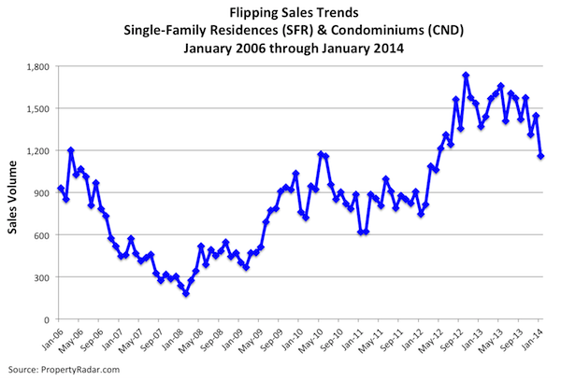
Wilson Investment Properties
Flipping Sales : California
www.tomwilsonproperties.com
Notes:
32

Slide 33
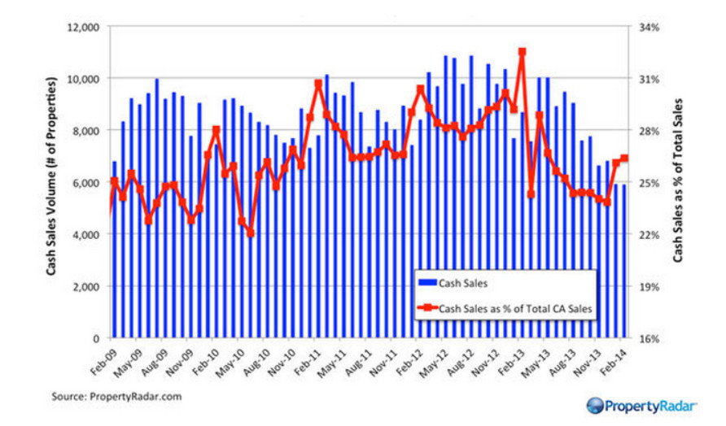
Wilson Investment Properties
CA Cash Sales
www.tomwilsonproperties.com
Notes:
33

Slide 34
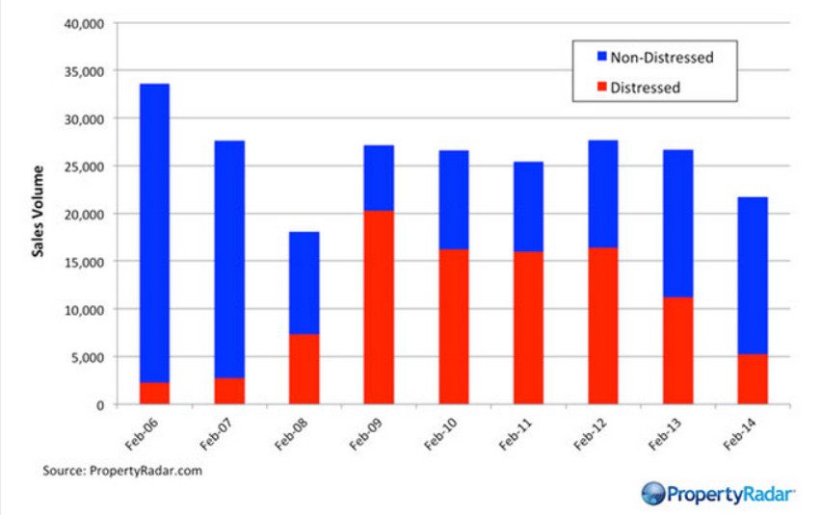
Wilson Investment Properties
Distressed vs Non-Distressed
www.tomwilsonproperties.com
Notes:
34

Slide 35
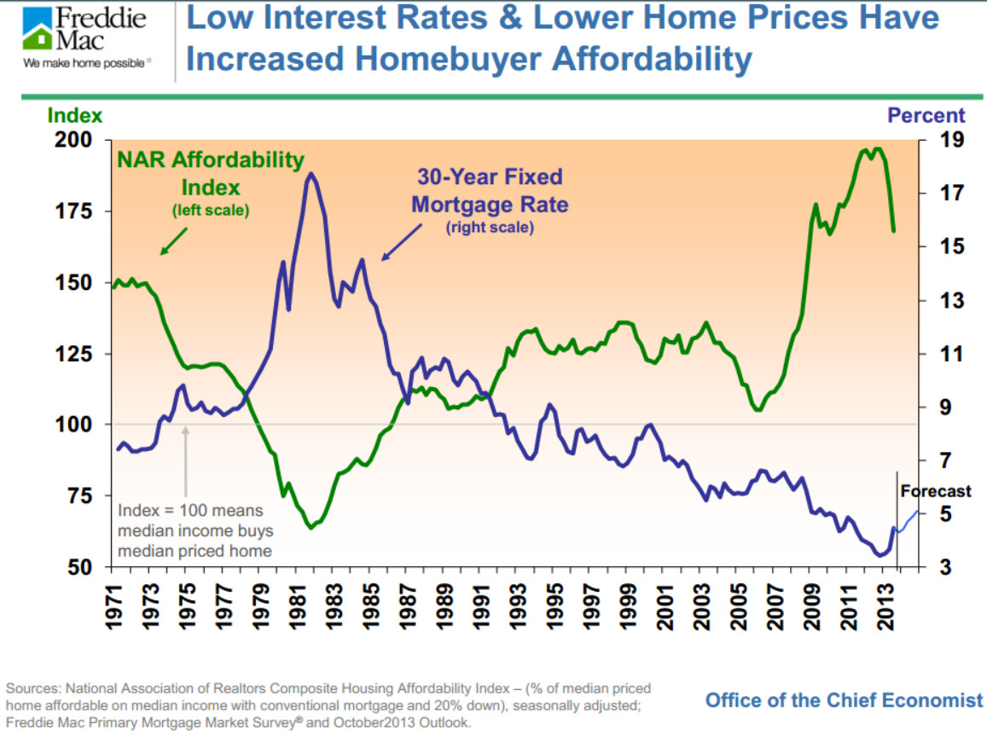
Wilson Investment Properties
Homebuyer Affordability
www.tomwilsonproperties.com
Notes:
35

Slide 36
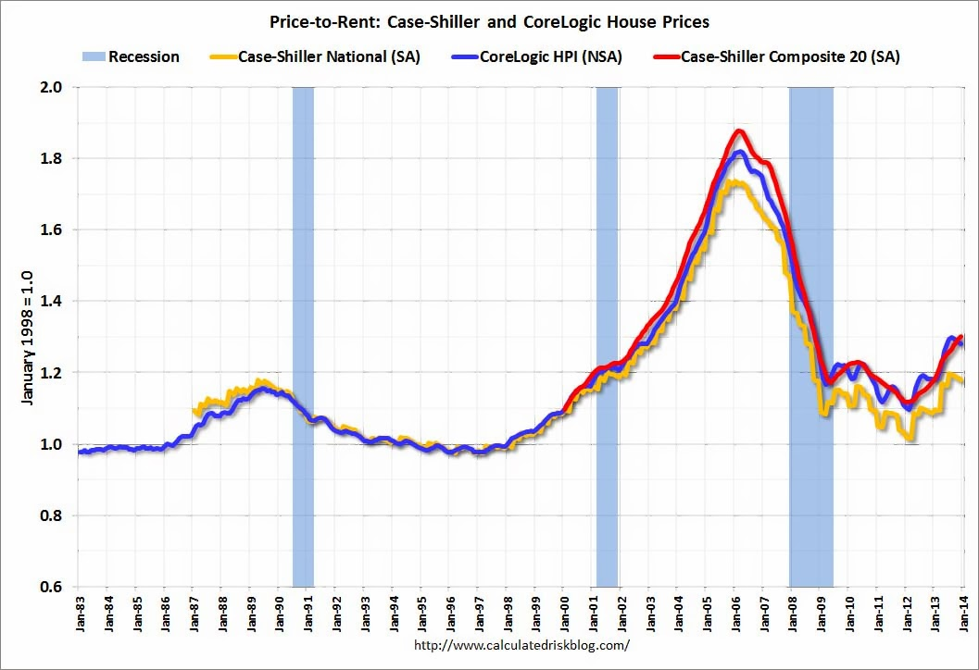
Wilson Investment Properties
Price-to-Rent Ratio
www.tomwilsonproperties.com
Notes:
36

Slide 37
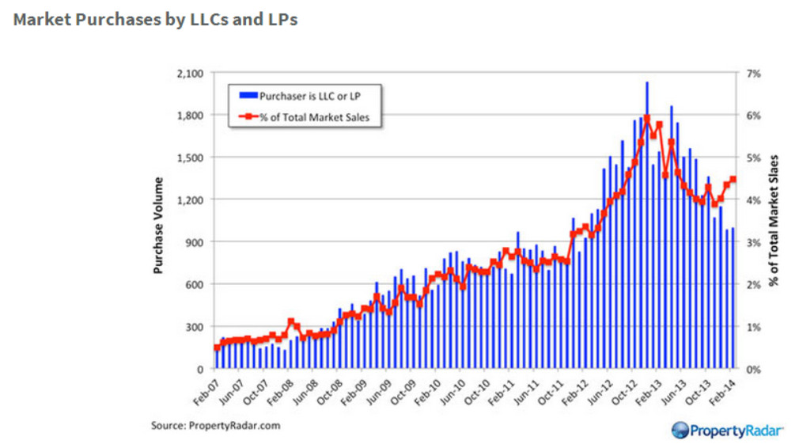
Wilson Investment Properties
Purchases : LLCs and LPs
www.tomwilsonproperties.com
Notes:
37

Slide 38
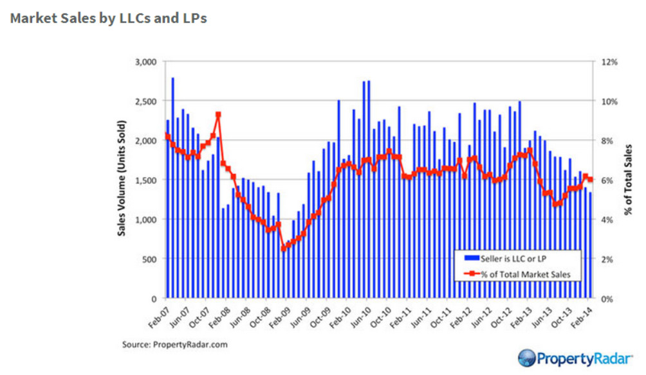
Wilson Investment Properties
Sales : LLCs and LPs
www.tomwilsonproperties.com
Notes:
38

Slide 39
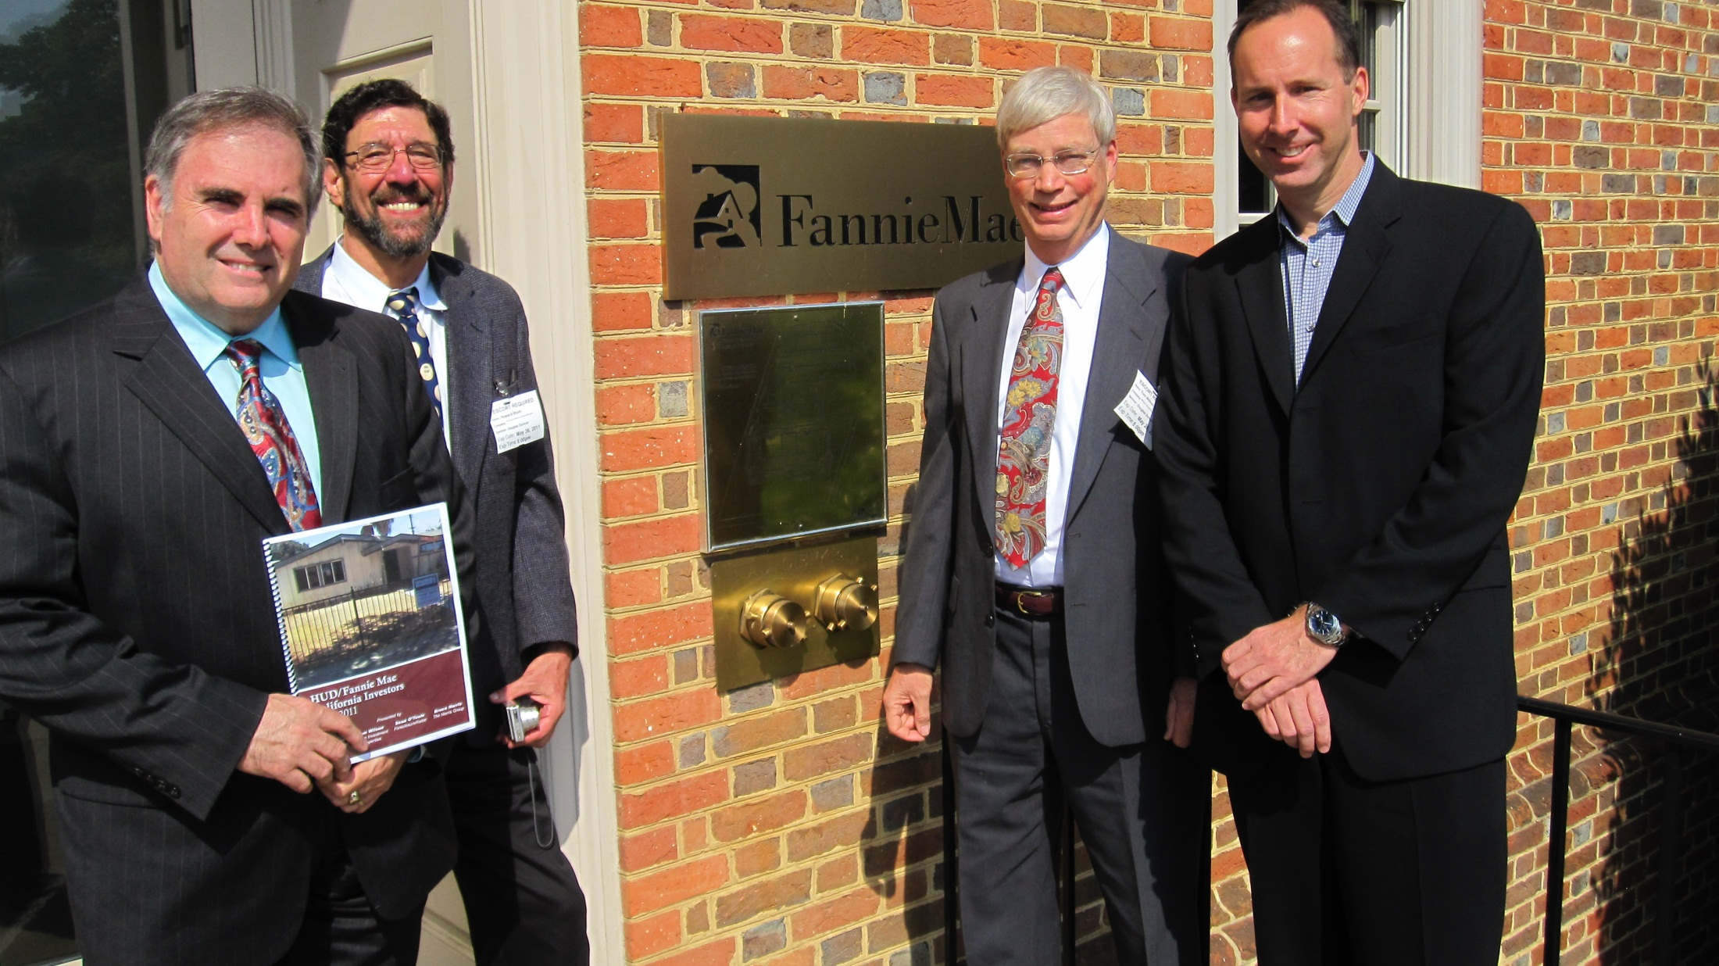
Bruce Norris, Howard Blum, Tom Wilson, Sean O’Toole

Slide 40
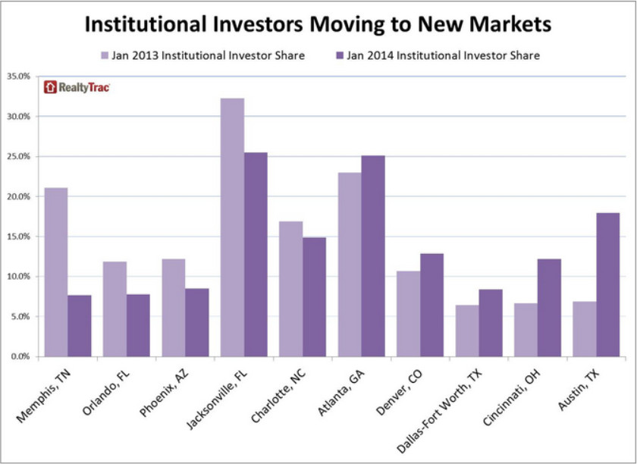
Wilson Investment Properties
Hedge Funds
www.tomwilsonproperties.com
Notes:
40

Slide 41
Wilson Investment Properties
Flip Examples
www.tomwilsonproperties.com
Notes:
41

Slide 42
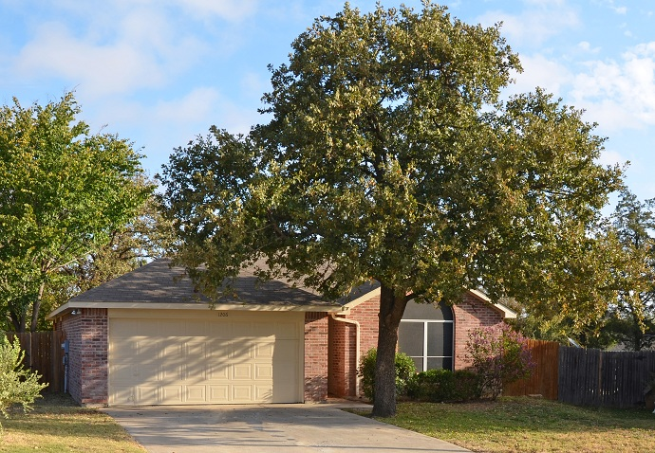
Wilson Investment Properties
1206 Hidden Oaks, Mansfield, TX 76063
3/2/2 1489ft 1999
www.tomwilsonproperties.com

Slide 43
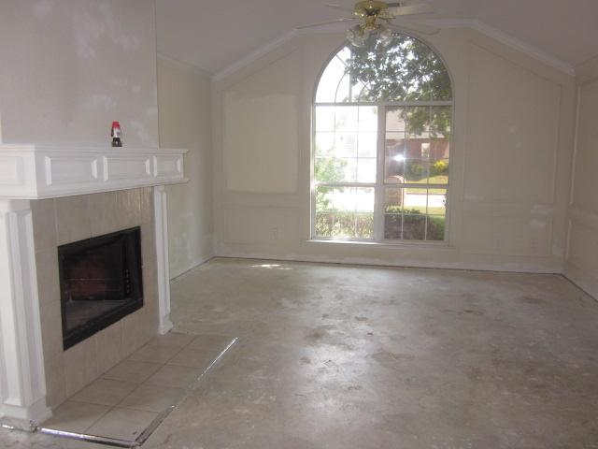
Wilson Investment Properties
1206 Hidden Oaks, Mansfield, TX 76063
BEFORE
www.tomwilsonproperties.com

Slide 44
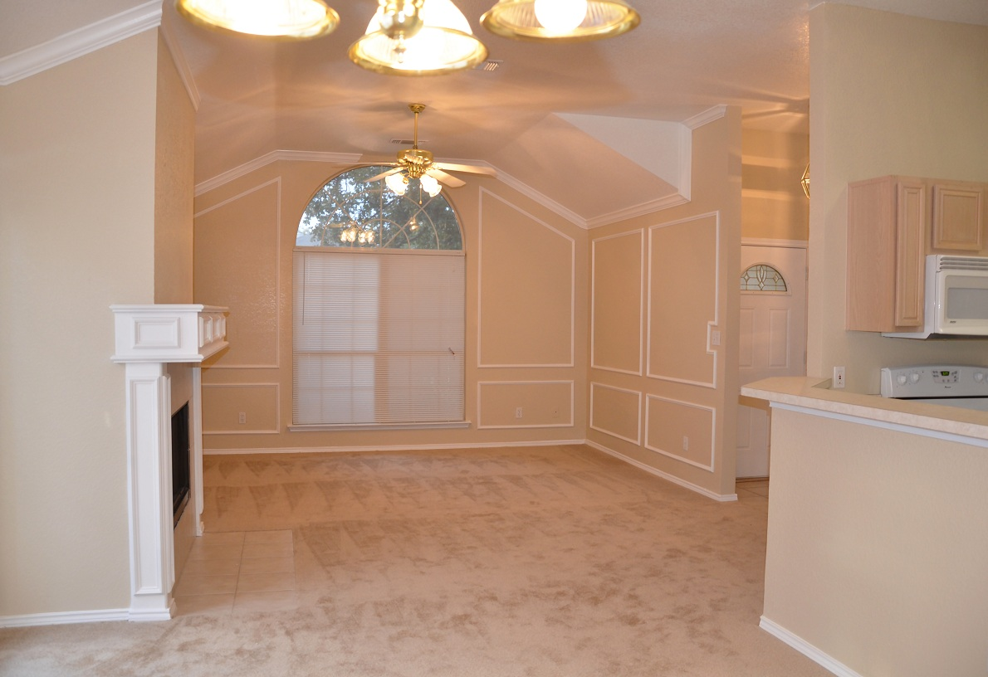
Wilson Investment Properties
1206 Hidden Oaks, Mansfield, TX 76063
AFTER
www.tomwilsonproperties.com

Slide 45
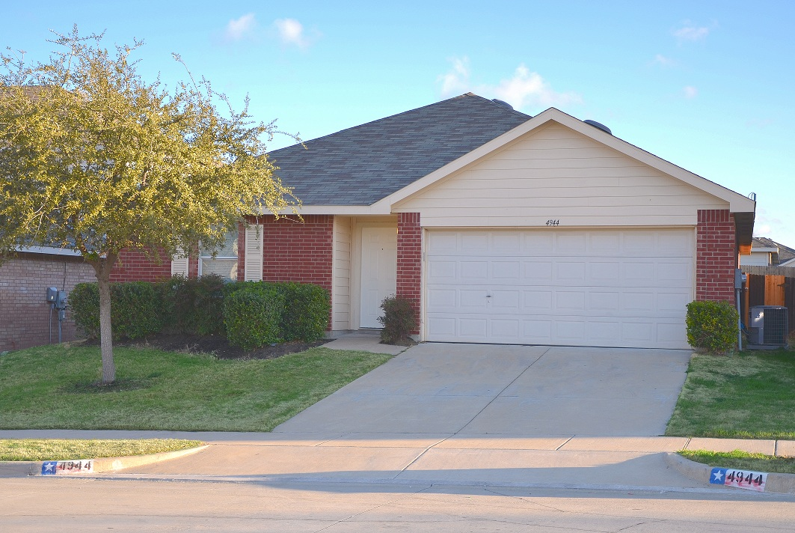
Wilson Investment Properties
4944 Creek Ridge Trail, Fort Worth, TX 76179
4/2/2 1763ft, 2004
www.tomwilsonproperties.com

Slide 46
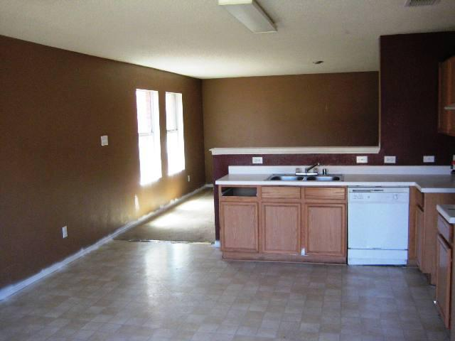
Wilson Investment Properties
4944 Creek Ridge Trail, Fort Worth, TX 76179
Kitchen
BEFORE
www.tomwilsonproperties.com

Slide 47
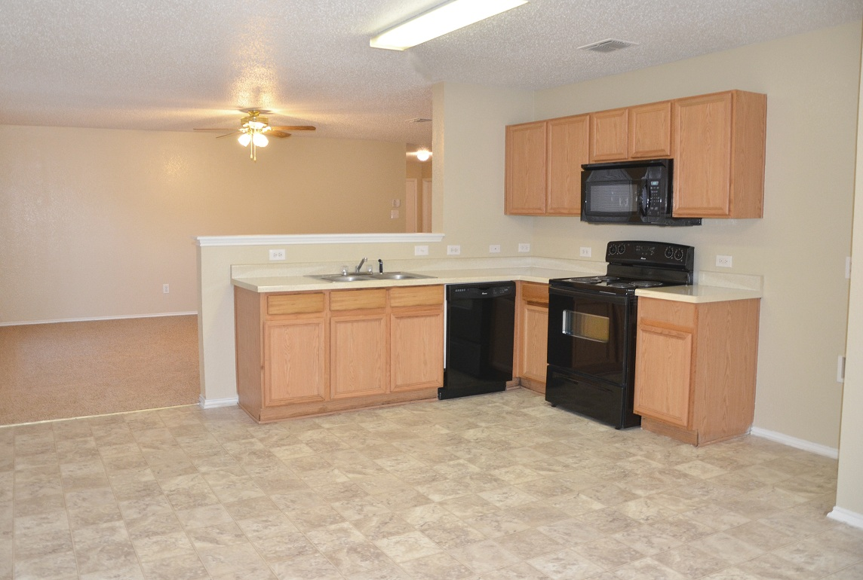
Wilson Investment Properties
4944 Creek Ridge Trail, Fort Worth, TX 76179
Kitchen
AFTER
www.tomwilsonproperties.com

Slide 48
Wilson Investment Properties
Dallas / WIP Average Flip 4/2/2 2000ft
Purchase Price: | $89,000
Total Hold Time | 91 days
Purchase Closing: | $4,416
Resale Price: | $119,000
Resale Closing: | $2,467
Total Rehab: | $14,010
Debt Service: | $2520
Gross Profit | 9%
Overhead | 3%
Net Profit: | 6%
www.tomwilsonproperties.com

Slide 49
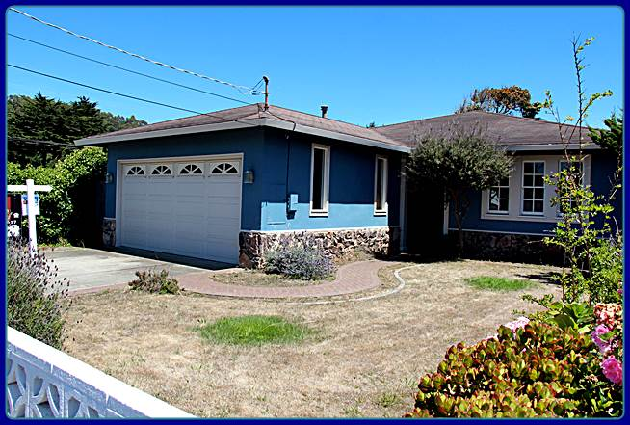
Wilson Investment Properties
460 Lancaster
3/2/2 1510ft, 1972
BEFORE
www.tomwilsonproperties.com
Notes:
49

Slide 50
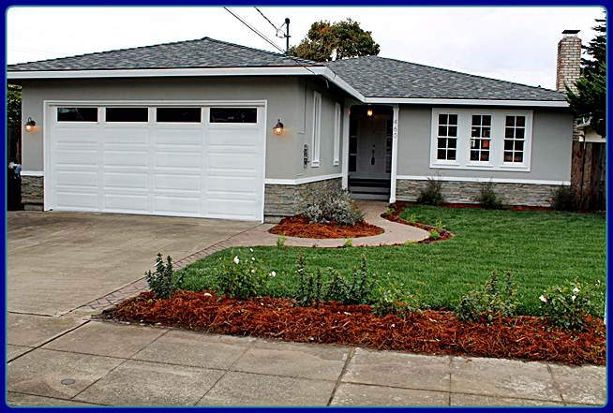
Wilson Investment Properties
460 Lancaster
3/2/2 1510ft, 1972
AFTER
www.tomwilsonproperties.com
Notes:
50

Slide 51
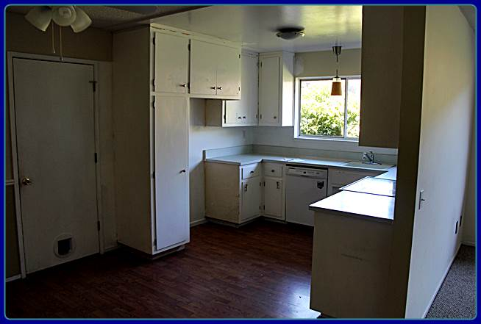
Wilson Investment Properties
460 Lancaster
Kitchen
BEFORE
www.tomwilsonproperties.com
Notes:
51

Slide 52
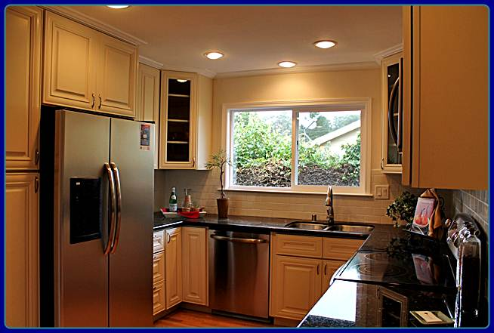
Wilson Investment Properties
460 Lancaster
Kitchen
AFTER
www.tomwilsonproperties.com
Notes:
52

Slide 53
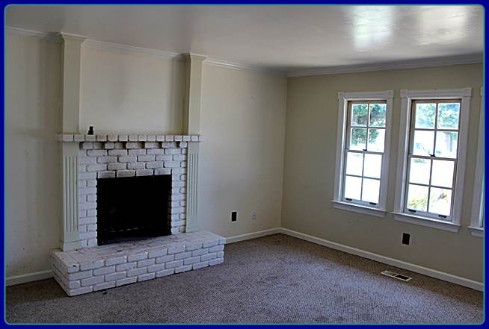
Wilson Investment Properties
460 Lancaster
Living Room
BEFORE
www.tomwilsonproperties.com
Notes:
53

Slide 54
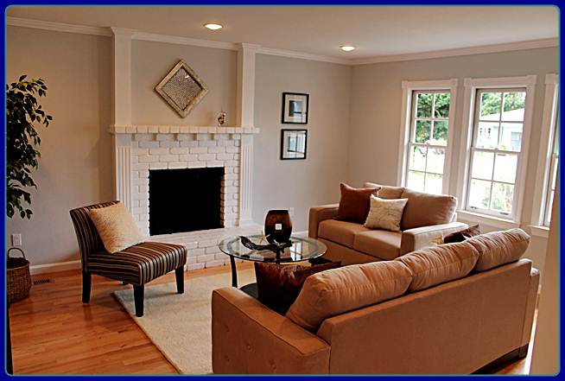
Wilson Investment Properties
460 Lancaster
Living Room
AFTER
www.tomwilsonproperties.com
Notes:
54

Slide 55
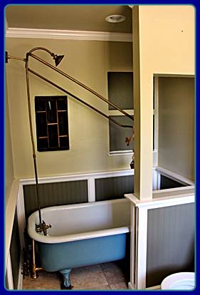
Wilson Investment Properties
460 Lancaster
Master Bathroom
BEFORE
www.tomwilsonproperties.com
Notes:
55

Slide 56
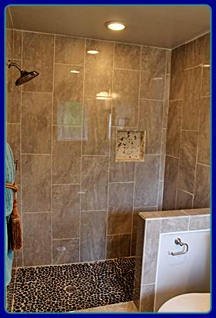
Wilson Investment Properties
460 Lancaster
Master Bathroom
AFTER
www.tomwilsonproperties.com
Notes:
56

Slide 57
Wilson Investment Properties
Bay Area Flip Example Cosmetic & Modest Added Value
460 Lancaster Ave.
Purchase Price: | $455,000
Resale Price: | $620,000
Year Built: | 1972, 2012
Bedrooms/Bath/Gar | 3/2/2
Square Feet: | 1,510
Lot Size: | 5,500
Rehab Cost | $45,000
Profit | $58,000
www.tomwilsonproperties.com

Slide 58
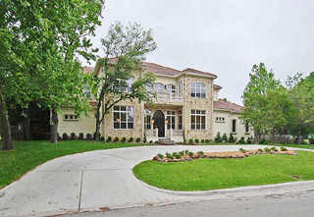
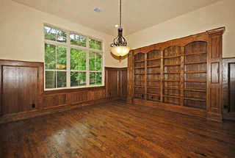
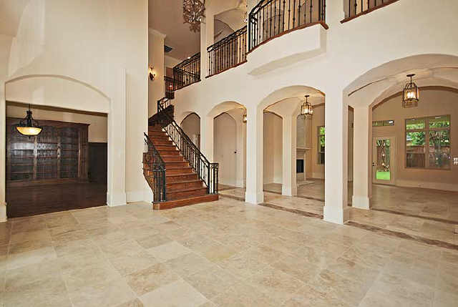
Wilson Investment Properties
6431 Preston Crest Lane, Dallas, TX 75230
Price: | $1,300,000
Year Built: | 2007
Bedrooms/Bath/Gar | 5/6/4
Purchase | $450,000
Construction | $750,000
Square Feet: | 7,596
Lot Size: | 25,269
www.tomwilsonproperties.com

Slide 59
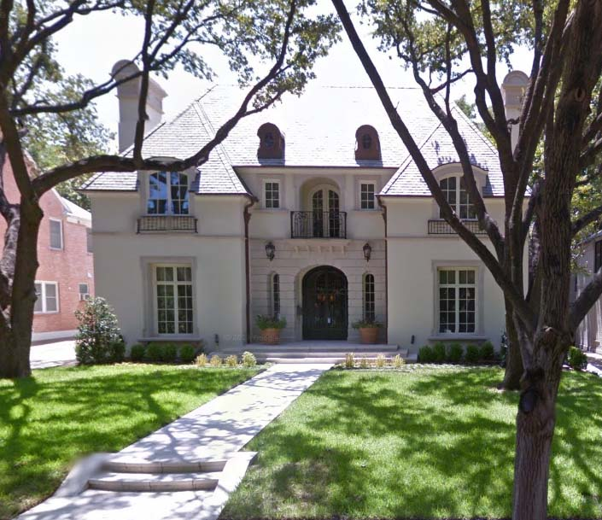
Wilson Investment Properties
4323 Versailles Avenue, Dallas, TX 75205 Price: $3,700,000 Bathrooms: 6 Year Built: 2007 Bedrooms: 5 Lot Size: 9,975
Square Feet: 6,441
www.tomwilsonproperties.com

Slide 60
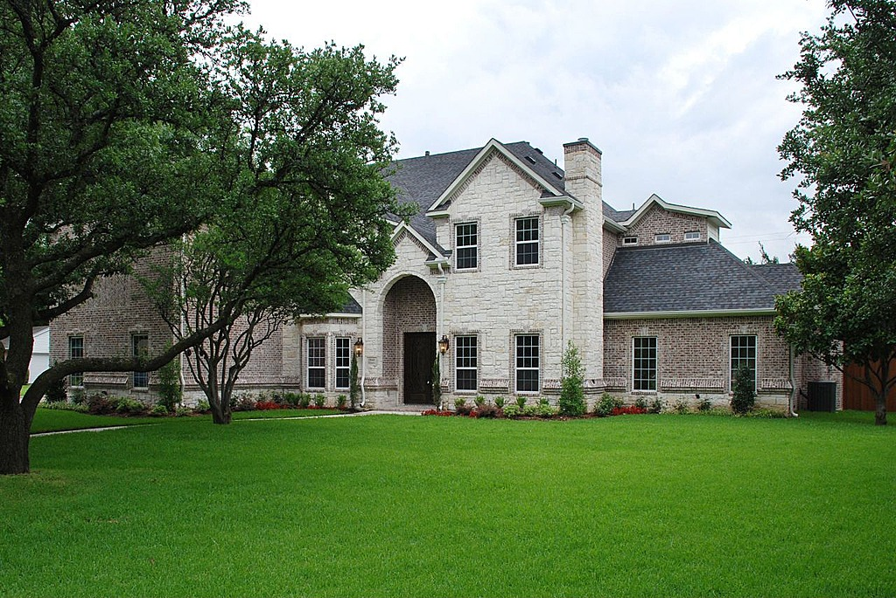
Wilson Investment Properties
5840 Williamstown Road, Dallas, TX 75230 Price: $1,180,000 Bathrooms: 5.25 Year Built: 2007 Bedrooms: 5 Lot Size: 17,860
Square Feet: 6,100
www.tomwilsonproperties.com

Slide 61
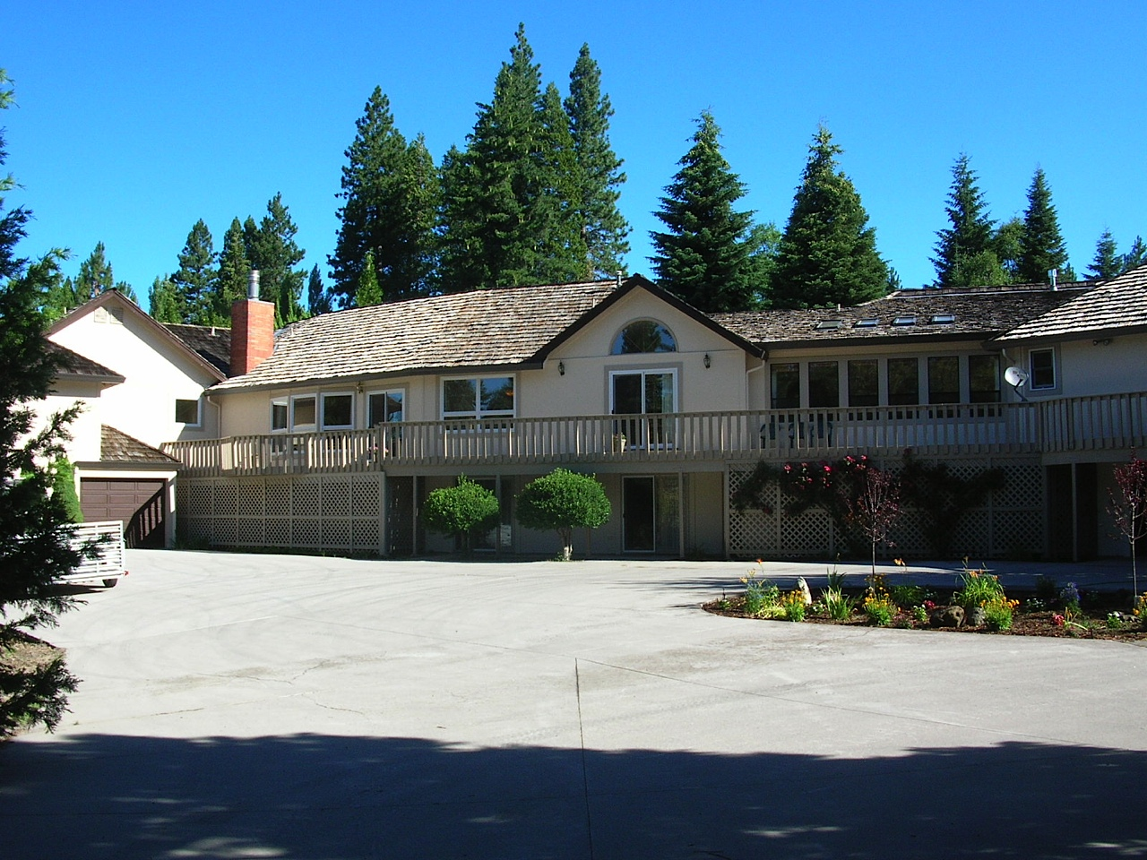
Wilson Investment Properties
555 Shasta Way, Mount Shasta, CA 96067 Purchase price: $600k Bedrooms: 6 Resale Price: $760k Bathrooms: 11 Year Built: 1980 Sq. Feet: 9,170 Lot Size: 88,975
www.tomwilsonproperties.com

Slide 62
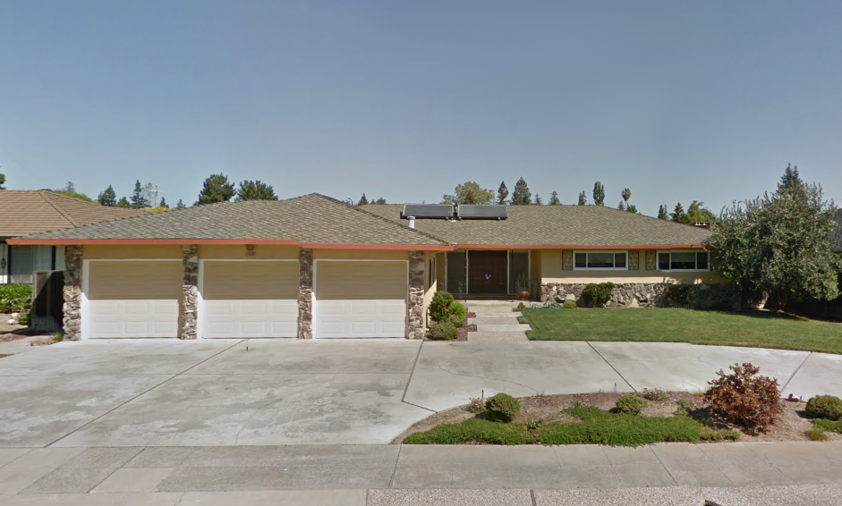
Wilson Investment Properties
1429 Dry Creek Road, San Jose, CA 95125
Front View
BEFORE
www.tomwilsonproperties.com

Slide 63
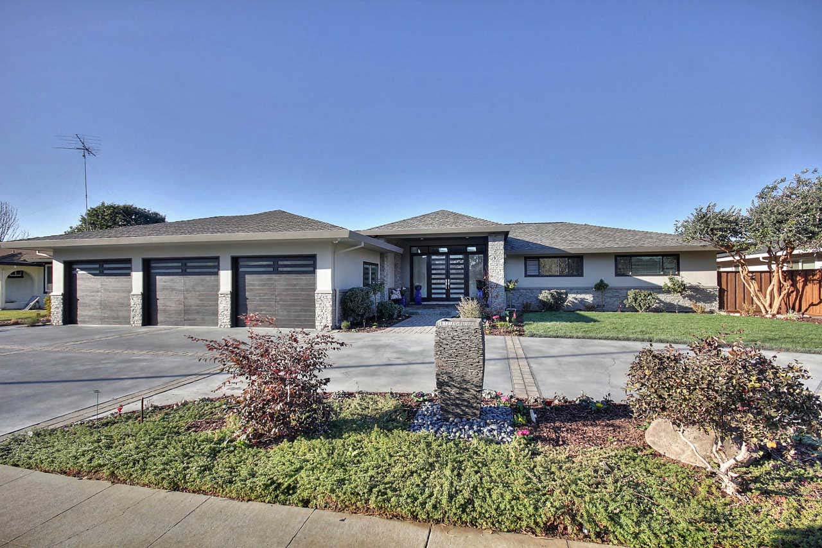
Wilson Investment Properties
1429 Dry Creek Road, San Jose, CA 95125
Front View
AFTER
www.tomwilsonproperties.com

Slide 64
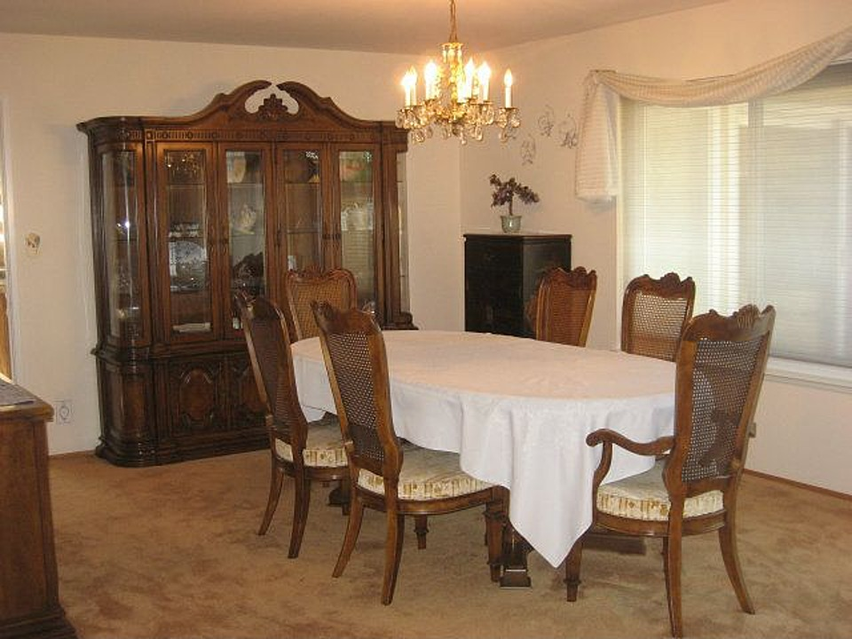
Wilson Investment Properties
1429 Dry Creek Road, San Jose, CA 95125
Dining Area
BEFORE
www.tomwilsonproperties.com

Slide 65
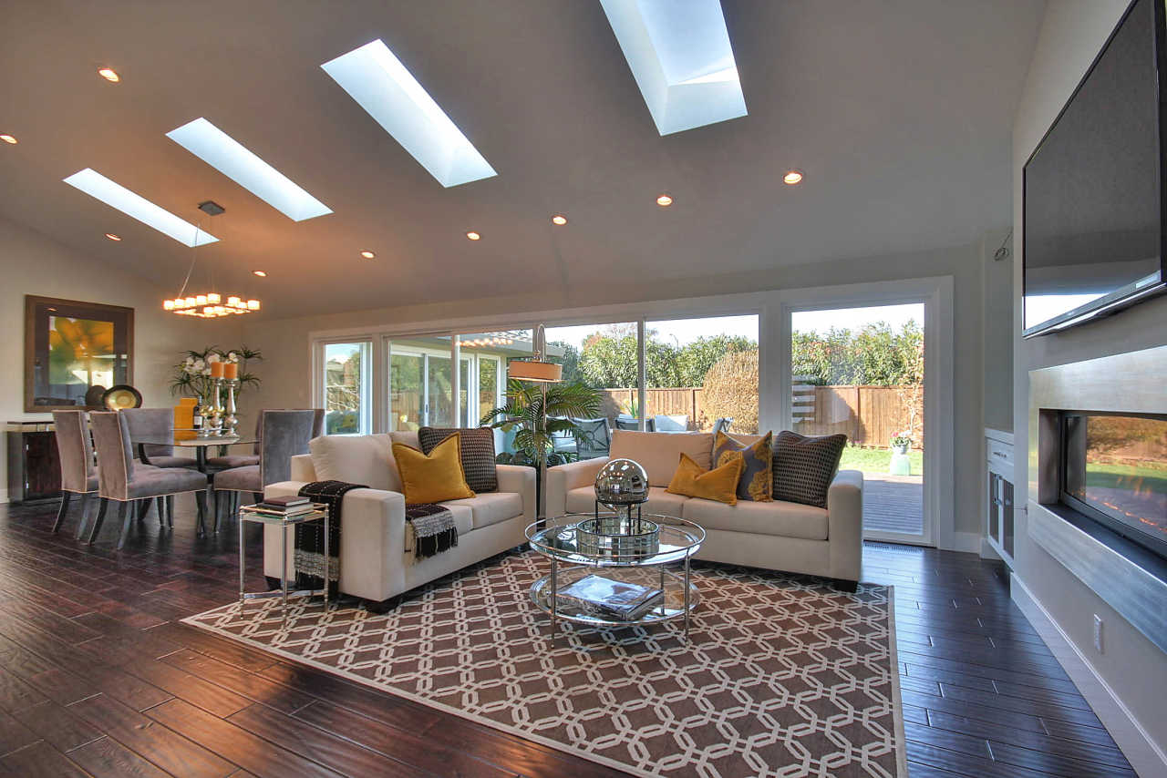
Wilson Investment Properties
1429 Dry Creek Road, San Jose, CA 95125
Great Room with Dining Area
AFTER
www.tomwilsonproperties.com

Slide 66
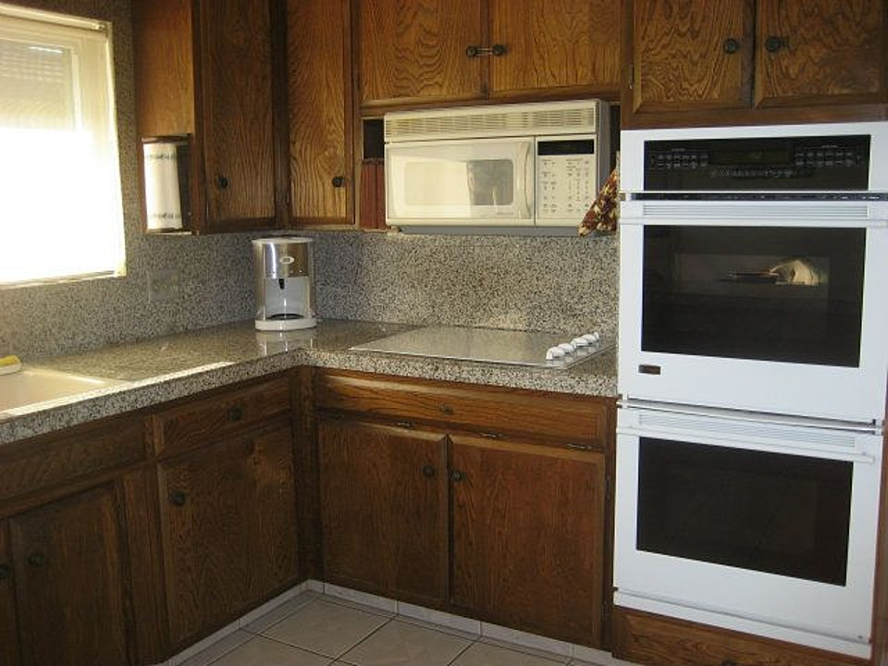
Wilson Investment Properties
1429 Dry Creek Road, San Jose, CA 95125
Kitchen
BEFORE
www.tomwilsonproperties.com

Slide 67
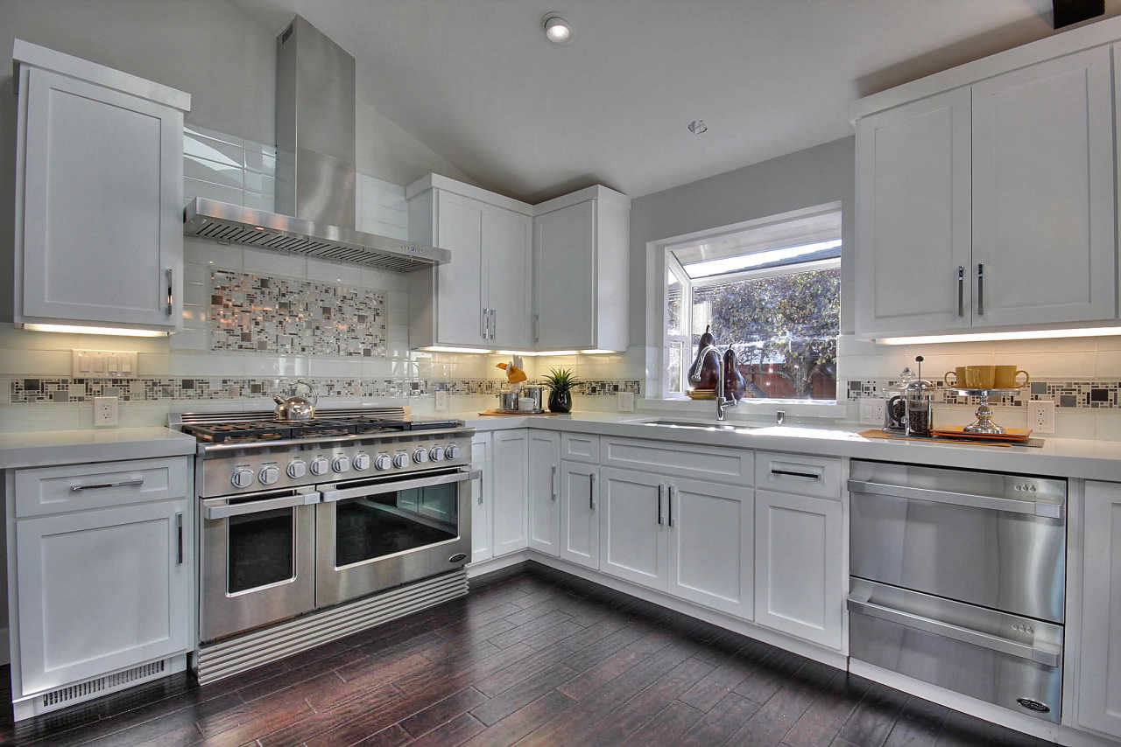
Wilson Investment Properties
1429 Dry Creek Road, San Jose, CA 95125
Kitchen
AFTER
www.tomwilsonproperties.com

Slide 68
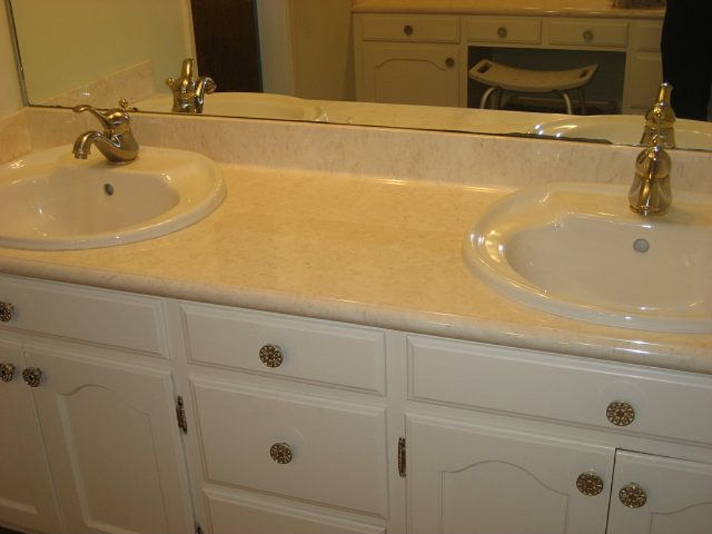
Wilson Investment Properties
1429 Dry Creek Road, San Jose, CA 95125
Master Bathroom
BEFORE
www.tomwilsonproperties.com

Slide 69
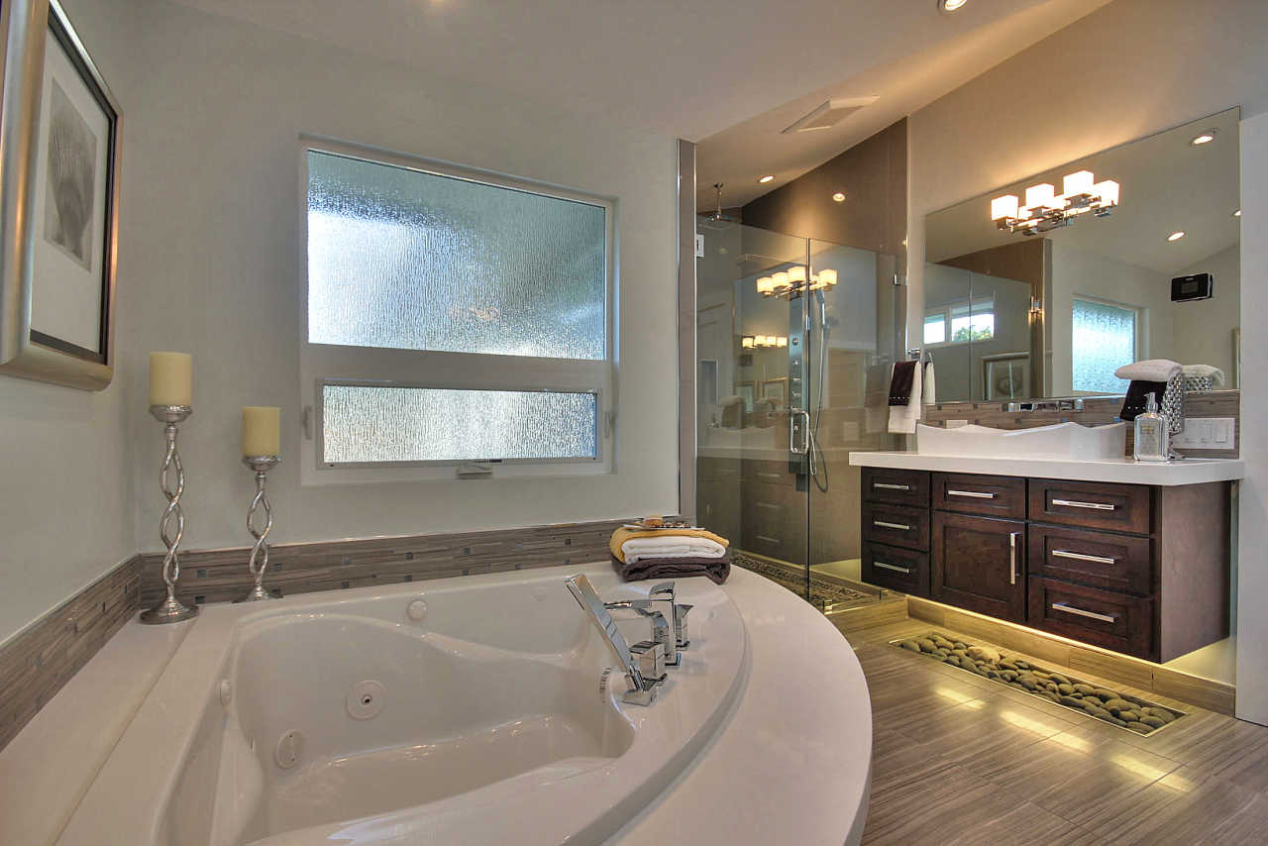
Wilson Investment Properties
1429 Dry Creek Road, San Jose, CA 95125
Master Bathroom
AFTER
www.tomwilsonproperties.com

Slide 70
Wilson Investment Properties
Silicon Valley Flip Example High-End High Added Value
1429 Dry Creek Rd. | 1967, 2013
Resale Price: | $1,945,000
Purchase Price: | $1,200,000
Bedrooms/Bath/Gar | 4/3.5/3
Rehab Costs | $512,000
Square Feet: | 3,100
Hold Time | 5 months
Lot Size: | 10,738
Profit | $102,000
www.tomwilsonproperties.com

Slide 71
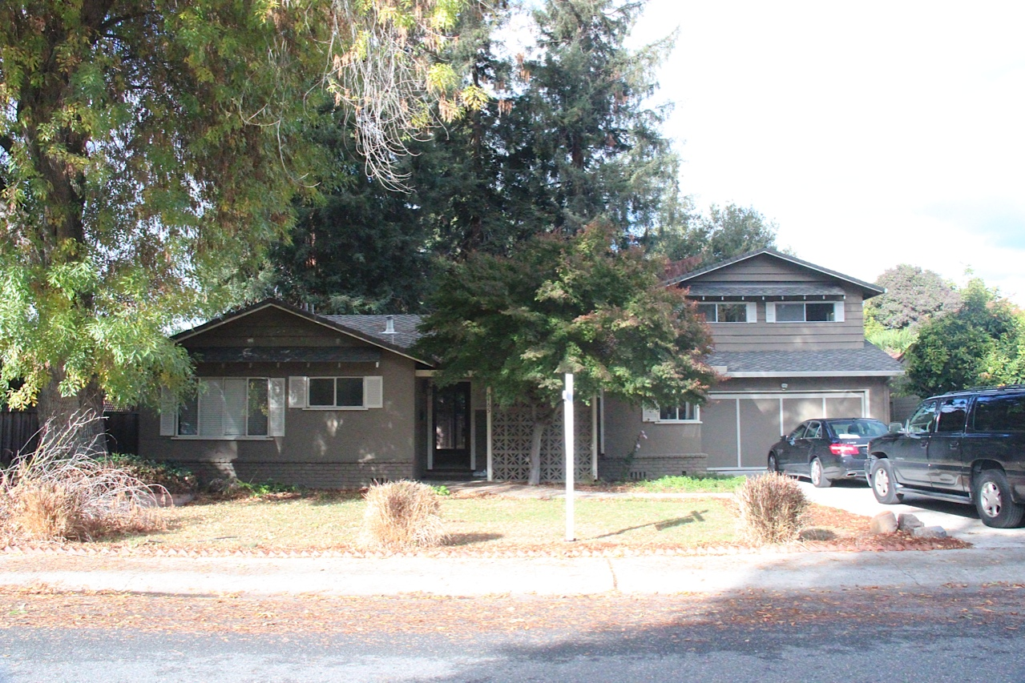
Wilson Investment Properties
1465 Bent Drive, Campbell, CA 95008
Front View
BEFORE
www.tomwilsonproperties.com

Slide 72
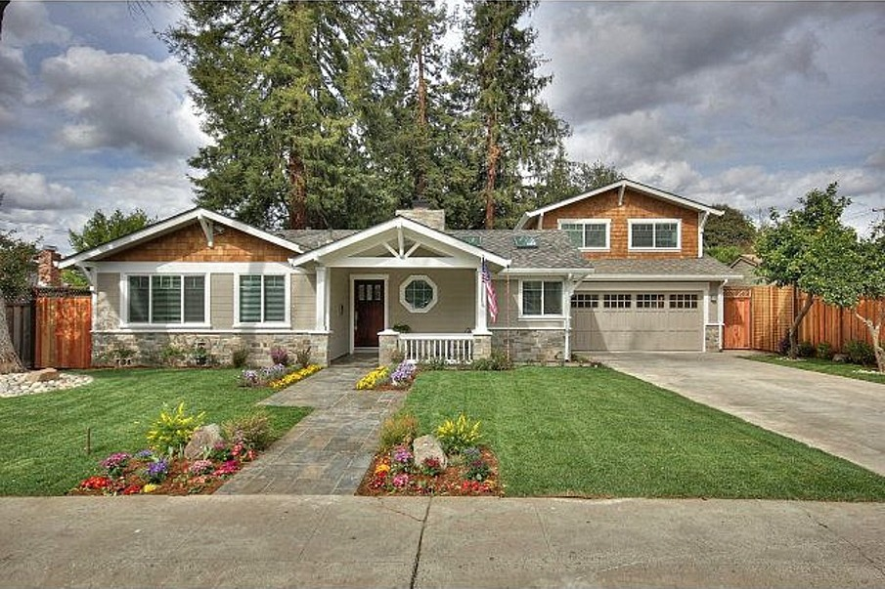
Wilson Investment Properties
1465 Bent Drive, Campbell, CA 95008
Front View
AFTER
www.tomwilsonproperties.com

Slide 73
Wilson Investment Properties
1465 Bent Drive, Campbell, CA 95008
Kitchen
BEFORE
www.tomwilsonproperties.com

Slide 74
Wilson Investment Properties
1465 Bent Drive, Campbell, CA 95008
Kitchen
AFTER
www.tomwilsonproperties.com

Slide 75
Wilson Investment Properties
1465 Bent Drive, Campbell, CA 95008
Family Room
BEFORE
www.tomwilsonproperties.com

Slide 76
Wilson Investment Properties
1465 Bent Drive, Campbell, CA 95008
Family Room
AFTER
www.tomwilsonproperties.com

Slide 77
Wilson Investment Properties
1465 Bent Drive, Campbell, CA 95008
Back Patio
BEFORE
www.tomwilsonproperties.com
Notes:
77

Slide 78
Wilson Investment Properties
1465 Bent Drive, Campbell, CA 95008
Back Patio
AFTER
www.tomwilsonproperties.com
Notes:
78

Slide 79
Wilson Investment Properties
1465 Bent Drive, Campbell, CA 95008
Back Yard
BEFORE
www.tomwilsonproperties.com
Notes:
79

Slide 80
Wilson Investment Properties
1465 Bent Drive, Campbell, CA 95008
Back Yard
AFTER
www.tomwilsonproperties.com
Notes:
80

Slide 81
Wilson Investment Properties
Silicon Valley Flip Example High-End High Added Value
1465 Bent Drive
Purchase Price: | $550,000
Purchase Closing: | $1,177
Resale Price: | $1,625,000
Hold Time | 15 Months
Resale Closing: | $87,893
Total Rehab: | $546,101
Debt Service: | $94,113
Soft Costs: | $19,272
Operating Costs: | $10,986
Net Profit: | $312,045
www.tomwilsonproperties.com

Slide 82
Wilson Investment Properties
Hidden Oaks Townhome Conversion Irving, TX Purchase Price: $2.9 million
Rehab: $525k
Units: 51
Price per Unit $57k each
Resale Price: $89k
Cost of Sales: $505k
Profit: $1.1 million

Slide 83
Wilson Investment Properties
Ascension Point
Condo Conversion 2500 Ascension Blvd Arlington, TX 76006 Price: $10 million
Price Per Unit: $56,800
ASP: $109,000
Sq. Feet: 193,000 176 units 14 buildings
www.tomwilsonproperties.com

Slide 84
Wilson Investment Properties
DO’S & DON’TS
www.tomwilsonproperties.com
Notes:
84

Slide 85
Wilson Investment Properties
Flipping Dont’s
Over-improve for the neighborhood.
www.tomwilsonproperties.com

Slide 86
Wilson Investment Properties
Flipping Dont’s
Underestimate rehab costs
www.tomwilsonproperties.com

Slide 87
Wilson Investment Properties
Flipping Dont’s
Over estimate resale price.
www.tomwilsonproperties.com

Slide 88
Wilson Investment Properties
Flipping Dont’s
Make many changes; they are costly.
www.tomwilsonproperties.com

Slide 89
Wilson Investment Properties
Flipping Dont’s
Count on market appreciation.
www.tomwilsonproperties.com

Slide 90
Wilson Investment Properties
Flipping Dont’s
Follow the herd; instead find a niche.
www.tomwilsonproperties.com

Slide 91
Wilson Investment Properties
Flipping Dont’s
Feel invincible because you have success.
www.tomwilsonproperties.com

Slide 92
Wilson Investment Properties
Flipping Do’s
Get an experienced partner & consultants
www.tomwilsonproperties.com

Slide 93
Wilson Investment Properties
Flipping Do’s
Buy in high demand areas.
www.tomwilsonproperties.com

Slide 94
Wilson Investment Properties
Silicon Valley Job Growth
www.tomwilsonproperties.com
Notes:
94

Slide 95
Wilson Investment Properties
Best Market to Flip : Q3 2013
#1 San Jose – Sunnyvale – Santa Clara
www.tomwilsonproperties.com
Notes:
95

Slide 96
Wilson Investment Properties
Best Market to Flip : Q3 2013
#2 San Francisco – Oakland - Fremont
www.tomwilsonproperties.com
Notes:
96

Slide 97
Wilson Investment Properties
Flipping Do’s
Line up lenders before looking for your deal.
www.tomwilsonproperties.com

Slide 98
Wilson Investment Properties
Flipping Do’s
Focus on non-listed properties.
www.tomwilsonproperties.com

Slide 99
Wilson Investment Properties
Flipping Do’s
Purchase the cheapest house on the block.
www.tomwilsonproperties.com

Slide 100
Wilson Investment Properties
Flipping Do’s
Put more money in the front than the back.
www.tomwilsonproperties.com

Slide 101
Wilson Investment Properties
Flipping Do’s
Get fixed bids for major work.
www.tomwilsonproperties.com

Slide 102
Wilson Investment Properties
Flipping Do’s
Minimize risk; permit structural work, 1099, insure.
www.tomwilsonproperties.com

Slide 103
Wilson Investment Properties
Flipping Do’s
Pay your GC directly; let them pay the workers.
www.tomwilsonproperties.com

Slide 104
Wilson Investment Properties
2014 Economic Forecast
www.tomwilsonproperties.com
Notes:
104

Slide 105
Wilson Investment Properties
Tom’s Take Aways
Inflation is inevitable
Political pressure will keep interest rates relatively low
You will be prudent to invest in hard assets; oil & gas, precious metals, agriculture, real estate
Flipping is risky; take the money while you can but watch market carefully
Real Estate long term holds will continue to give good cash flow & inflation protection
Stay educated!
www.tomwilsonproperties.com

Slide 106
Buy Assets That Produce Income Now
www.tomwilsonproperties.com

Slide 107
Bruce Norris – Market Timing Expert
www.tomwilsonproperties.com

Slide 108
Wilson Investment Properties
Free Weekly Newsletter
www.tomwilsonproperties.com

Slide 109
Wilson Investment Properties
RE360 Radio Show
KDOW 1220 AM
Every Wednesday at 2 pm PST & 9 pm PST
RE360 is an informative and engaging hour discussing everything you need to know about the world of real estate.
We provide you with insight and guidance about how to buy, sell, finance, and invest in real estate, and much more.
www.tomwilsonproperties.com

Slide 110
Wilson Investment Properties
Investor Education Resources
tomwilsonproperties.com
WIP Website Investor Info
WIP Weekly Newsletter
Report: How to Select the Best Investment Region & Property
Real Estate 360 Wed 2 & 9pm –
KDOW 1220am –The Wall Steet Business Network
www.tomwilsonproperties.com

