Slide 1
You said your were OCD about cleaning…
Your Move-out inspection showed, That was a Lie!

Slide 2
Multi-Family Property Management DO I need it? How Much Does it cost?

Slide 3
do I need an On-site Manager?
16 units or more require an on-site manager
The On-site manager must live at the property
The On-site manager must have “Posted” hours
The On-site manager is your Employee!!!
(Workman's Comp. SSI, Taxes, HR)

Slide 4
What does an On-site Manager do?
Janitorial –
Cleaning the Laundry Room
Pick-up the Grounds
Clean Vacant Units

Slide 5
What does an On-site Manager do?
Maintenance –
Prepare Vacant Units for Rent
Routine Maintenance in Occupied Units
Emergency Repairs

Slide 6
What does an On-site Manager do?
Leasing –
Place Ads for Vacant Units
Show Properties
Screen Tenants
Prepare Contracts
Prepare and Deliver Notices

Slide 7
What does an On-site Manager do?
Accounting –
Collect Rents
Collect Deposits
Return Security Deposits to Past Tenants

Slide 8
Can your On-site manager handle it?
Class “A”, “B” or “C”

Slide 9
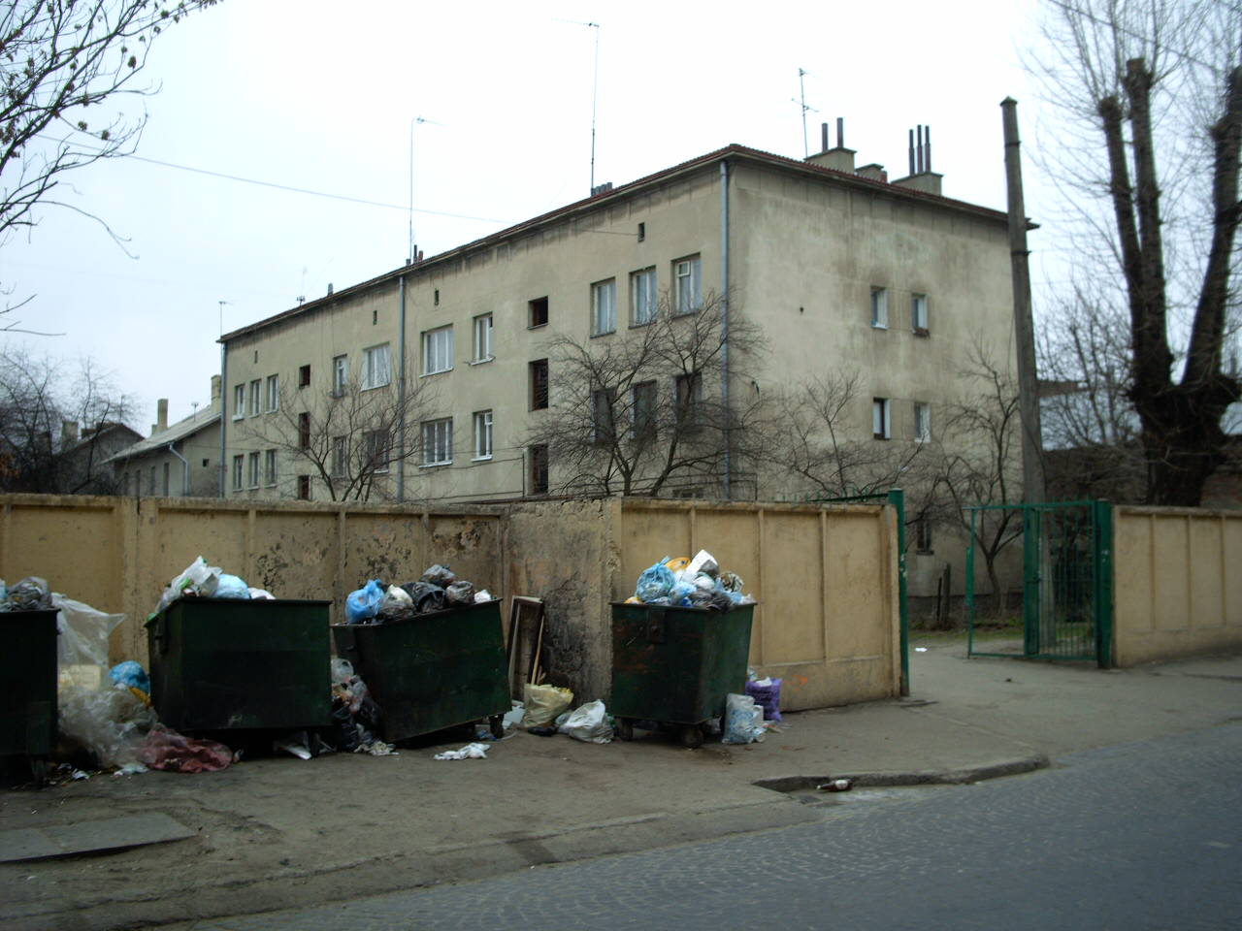
Can your On-site manager Handle it?

Slide 10
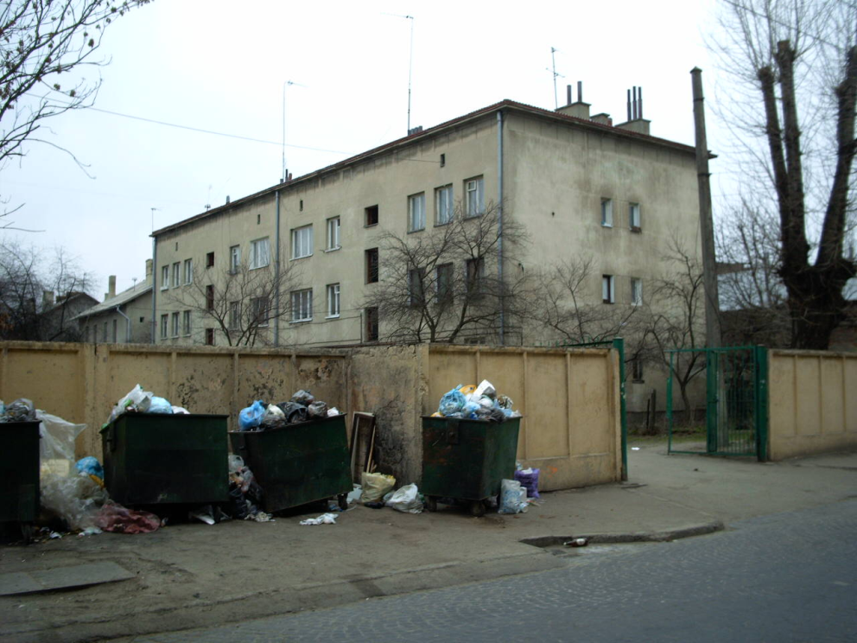
Property Class Matters… A, B, or C
Janitorial
Maintenance
Leasing
Accounting

Slide 11
How much do On-site Managers get paid?

Slide 12
How much do On-site Managers get paid?
Two Methods –
Lodging Credit or The “Two Check” System”
(Monthly value is limited to 564.81 per month)
Lodging Credit / Minimum wage = Max. number of hours per month to earn the credit. Employee must be paid min. wage beyond that
Overtime, Workman's compensation, Tax withholdings
One Free Living Unit Plus Hourly Pay

Slide 13
# units VS Net Income
15-unit apartment building = $15,000/ Mo.
16-unit apartment building = $16,000 -On-site Mgr.
The larger Property Will Net Less!!!

Slide 15
# units VS Net Income
15-unit apartment building = $15,000/ Mo.
16-unit apartment building = $16,000 -On-site Mgr.
The larger Property Will Net Less!!!

Slide 16
On-site managers for less than 16 units?
Duties – Janitorial, Laundry Room, Pool
Compensation – Min. Wage, WC, State and Federal Witholding

Slide 17
Should I hire a Property Management Company Too?
That Depends…
Landlord/Tenant Law
Human Resources Law
(16 units and over)

Slide 18
How much does a Property Management Company Charge?
Class A Properties 3-5%
Class B Properties 6-8 %
Class C Properties 9-15%

Slide 19
Can The On-site Handle It?
Janitorial (Laundry room, grounds clean-up)
Maintenance
Showing Properties
Writing and Executing Leases
Rent Collections and Accounting
Pool/Spa Daily Testing

Slide 20
Not Sure?
Ask

Slide 21
Look Before you Leap
Get 2 or 3 Bids From Property Managers
Before you Buy….Not After.

Slide 22
Do not’s
On-site managers should not be the property police
Never make handshake deals with on-site managers
Never violate HR rules
Never violate Tenant/Landlord laws
Keep good records

