Slide 1
David Granzella
916.223.5564
www.NorCalREIA.com

Slide 2
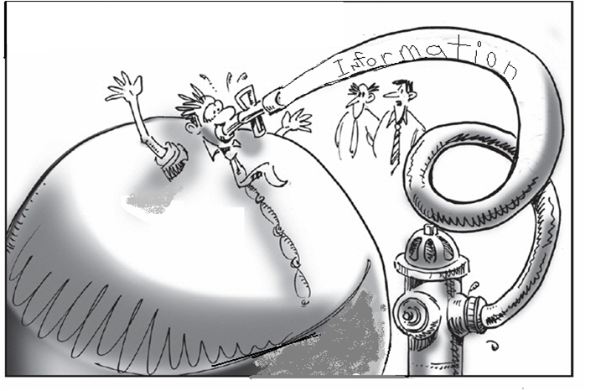
David said to take notes!
Notes:
2

Slide 3
Presentation posted under
“Free Resources”
www.NorCalREIA.com

Slide 4
We want to thank those men
& women who have served our country and provided us with
the freedom we have today.

Slide 5
Pledge of Allegiance
I pledge allegiance to the flag of the United States of America and to the republic for which it stands: one nation under God, indivisible, with liberty and justice for all.

Slide 6
Disclaimer:
This information is designed to provide accurate and authoritative information in regard to the subject matter covered. It is offered with the understanding that the presenters are not engaged in rendering legal, accounting, or other professional services. If legal or other expert advice is required, the services of a competent professional should be sought.

Slide 7
Leslie
Keisha
Sam
Erik
Dennis
Al
Tapan

Slide 8
NorCalREIA Investment Club
Second Wednesday
Crowne Plaza, Madison & Hwy 80
Same place since 2004
Celebrating 13 years

Slide 9
How it ALL started

Slide 10
October 1, 2002
To: Betty & Chris @ Sacramento Professional Network
From: David Granzella
Well I am making a job / career change.
I am sick and tired of being sick and tired, being at the mercy of an employer.
I am building a property investment company, with some partners in crime who also want to be their own boss, while possibly having some control over our own lives. I was laid off at 35 & 45, and I have no intention of being laid off again at 55. So we will see what Gods will is for me and if I can stay out of the way.
Thanks one and all for your help and support.
David Granzella

Slide 12
Passion, Purpose
& Drive

Slide 13
Sum up in ONE word what you want most in your life…

Slide 14
Please do not confuse my gratitude for arrogance
or kindness for weakness

Slide 15
Sharpen our thinking
What is your Road to FREEDOM.
Why do you do what you do?
J.O.B. ?
Because you have too?

Slide 16
My Why…
Since 1956
Established 1986
(best of intentions)

Slide 17
MY Why?
I can make more money.
I can not make more time.

Slide 18
Therefore I use my time wisely.
Very wisely..
Did I mention I am selfish… ☺

Slide 19
Brendon Buchard
Circa 2006
(Life’s Golden Ticket)

Slide 20
"My success emanates from “my” plans and actions. Not reactions."

Slide 21
I find “my” purpose and peacefulness in each day, by achieving my own goals and dreams.
Otherwise “I” would be used as a resource to accomplish someone else’s.

Slide 22
“If you want to live a happy life, tie it to a goal, not to people or objects.”
A. Einstein

Slide 23
How we do this deal…

Slide 24
Find your Real Estate Niche..
Probate
Code Enforcement
Burn Outs – Fire
Court House Steps
Door Knocking…
Land Lording

Slide 25
Sacramento Real Estate market
Zillow ranked Sacramento #10
Hottest housing markets in 2017
Are you a Real Estate Investor cashing in
on the growth?
Or are you sitting on the sidelines.

Slide 26
“Men never plan to be failures; they simply fail to plan to be successful."
William A. Ward

Slide 27
Rehabbing is just a J.O.B.
Land lording is business…

Slide 30
How many Americans have $500 saved?
Having $500 in the bank for emergencies can give you a sense of financial security.
But for 41% of adults, it’s still a pipe dream.

Slide 31
How do we sharpen our thinking?
Starting TODAY!

Slide 32
Journal every day…
The $25 blank book – 5 minute journal
Yes, $25 for a bland book for you to write YOUR own story. Seriously… Great Value.
If your serious about becoming a wealthy, powerful, sophicated, healthy influential, cultured and unique individual, keep a journal. Don't trust your memory. When you listen to something valuable , write it down. When you come across something important write it down.
Jim Rohn

Slide 33
2017 Goals
Goal setting is an important method of: Deciding what you want to achieve in your life. Separating what's important from what's irrelevant, or a distraction. Motivating yourself. Building your self-confidence, based on successful achievement of goals.
Can you have your 2017 goals defined by our next meeting?

Slide 34
5 minute journal
Think & Grow Rich
The Compound Effect
How to win friends and
influence people

Slide 35
www.TheNorrisGroup.com
www.PropertyRadar.com

Slide 36
Facebook & Meet Up

Slide 37
Questions?
Presentation posted under
“Free Resources”
www.NorCalREIA.com

Slide 38
David Granzella
916.223.5564
www.NorCalREIA.com
“Free Resources”

