Slide 1
FIVE Strategies to find DEALS in a HOT market!
Laurel Sagen
Alcala Properties
laurel@alcalaprop.com
916-476-2380

Slide 2
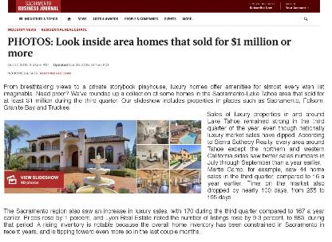

Slide 5
Sacramento Business Journal – Million Dollar Homes

Slide 6
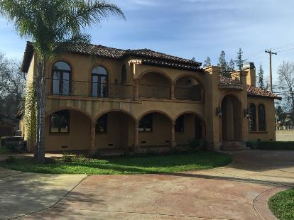
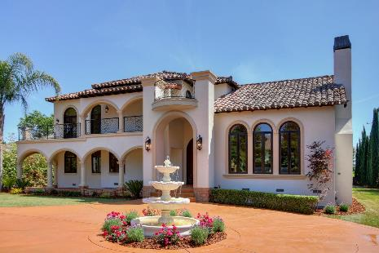
Sierra Oaks, Sacramento
Tuscan to Spanish Style

Slide 7
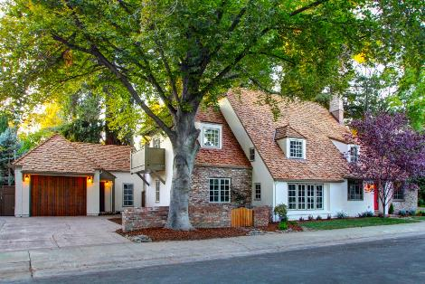
Landpark, Sacramento

Slide 8
1. MLS & Traditional RE Agents:
Be FIRST to Offer
Be LAST to Offer (Expired or Cancelled Listings/Fallouts)
Strong Offers
Find Mistakes
Make FIFTY (yep, 50) Offers a DAY

Slide 9
2. Off Market Deals with Agents & Other Professionals
Pros
VS
Cons
CPA’s/Attorney’s
Agents/Pocket Listings
Property Managers
Networking Clubs

Slide 10
3. Direct Marketing for Deals:
Driving for Dollars
Door Knocking
Bandit signs
Direct Mail
Social Media
Online & PPC

Slide 11
4. Partnering for Deals
Pros Vs. Cons

Slide 12
4. Partnering for Deals
Pros Vs. Cons

Slide 13
5. Wholesalers
Pros Vs. Cons

Slide 14
Age Old Formula: 70% Rule It works, just hard to find!
Example:
ARV $200k/70%- $140k = $60k
Commissions 6%, 12k
Buyer Credits 1%, 2k
Purchase Costs, 3k
Selling Costs, 3k
Hard Money Costs, 7k
Holding Costs, 3k
TOTAL PROFITS= $30k, 20%,
NOT BAD!

Slide 15
What is YOUR Competitive ADVANTAGE?
DO THE MATH, NUMBERS NEVER LIE!
PROFIT =
Sales Price
-Purchase Price
-Acquisition Costs
-Fix Up Costs
-Holding Costs
-Selling Costs

Slide 16
KNOW YOUR COSTS:
Acquisition Costs:
Realtors: Seller Pays?
What are the Costs?
Wholesalers?
What are the Costs?
Direct Marketing?
What are the Costs?

Slide 17
How can you get a BETTER Actual Purchase Price?
MLS
Direct Marketing
Partnering
Off Market Deals
Wholesalers

Slide 18
Purchase Costs:
Escrow and title ( Don’t Forget the Binder)
Transfer taxes
Money costs
Hard Money
Private Money
Personal Money
Partners
Banks

Slide 19
Holding Costs:
Utilities
Insurance
Money
HOA
Security
Length of time held

Slide 20
Renovation Costs:
Contractor/Subcontractors
Labor
Supplies
Design
Permits
Question:
How do these impact SALES PRICE and HOLDING TIME?

Slide 21
Selling Costs:
Commissions VS FSBO
Marketing
Staging
Credits
Question:
How do these impact the SELLING price & HOLDING time?

Slide 22
Laurel Sagen
Alcala Properties
Sacwholsales.com
laurel@alcalprop.ocm
sacwholesales@gmail.com
916-476-2380

