Slide 1
Gordie McCarty
gordie@parsonswalls.com
Professional licenses
Contractor and Real Estate Agent

Slide 2
Tonight:
This is a Club; want you guys to ask questions and provide input as we go. I put a few power point slides together to bring up conversations. This group has great ideas, lets share them with each other. I want to learn from you guys!
Need a realistic ARV (After Repair Value). What is it, why and how do we get that?
Merton will talk about the Repair/fix part
Show you some recent charts and info.

Slide 3
What is ARV?
After Repair Value (ARV). Exit number
This is the value of the property after we fix it up.
Sounds easy. The problem; can’t just look at a property and automatically know what it is worth. Need to research data and be realistic.
What we see is not what we are valuing.
This is the beginning number of my formula.

Slide 4
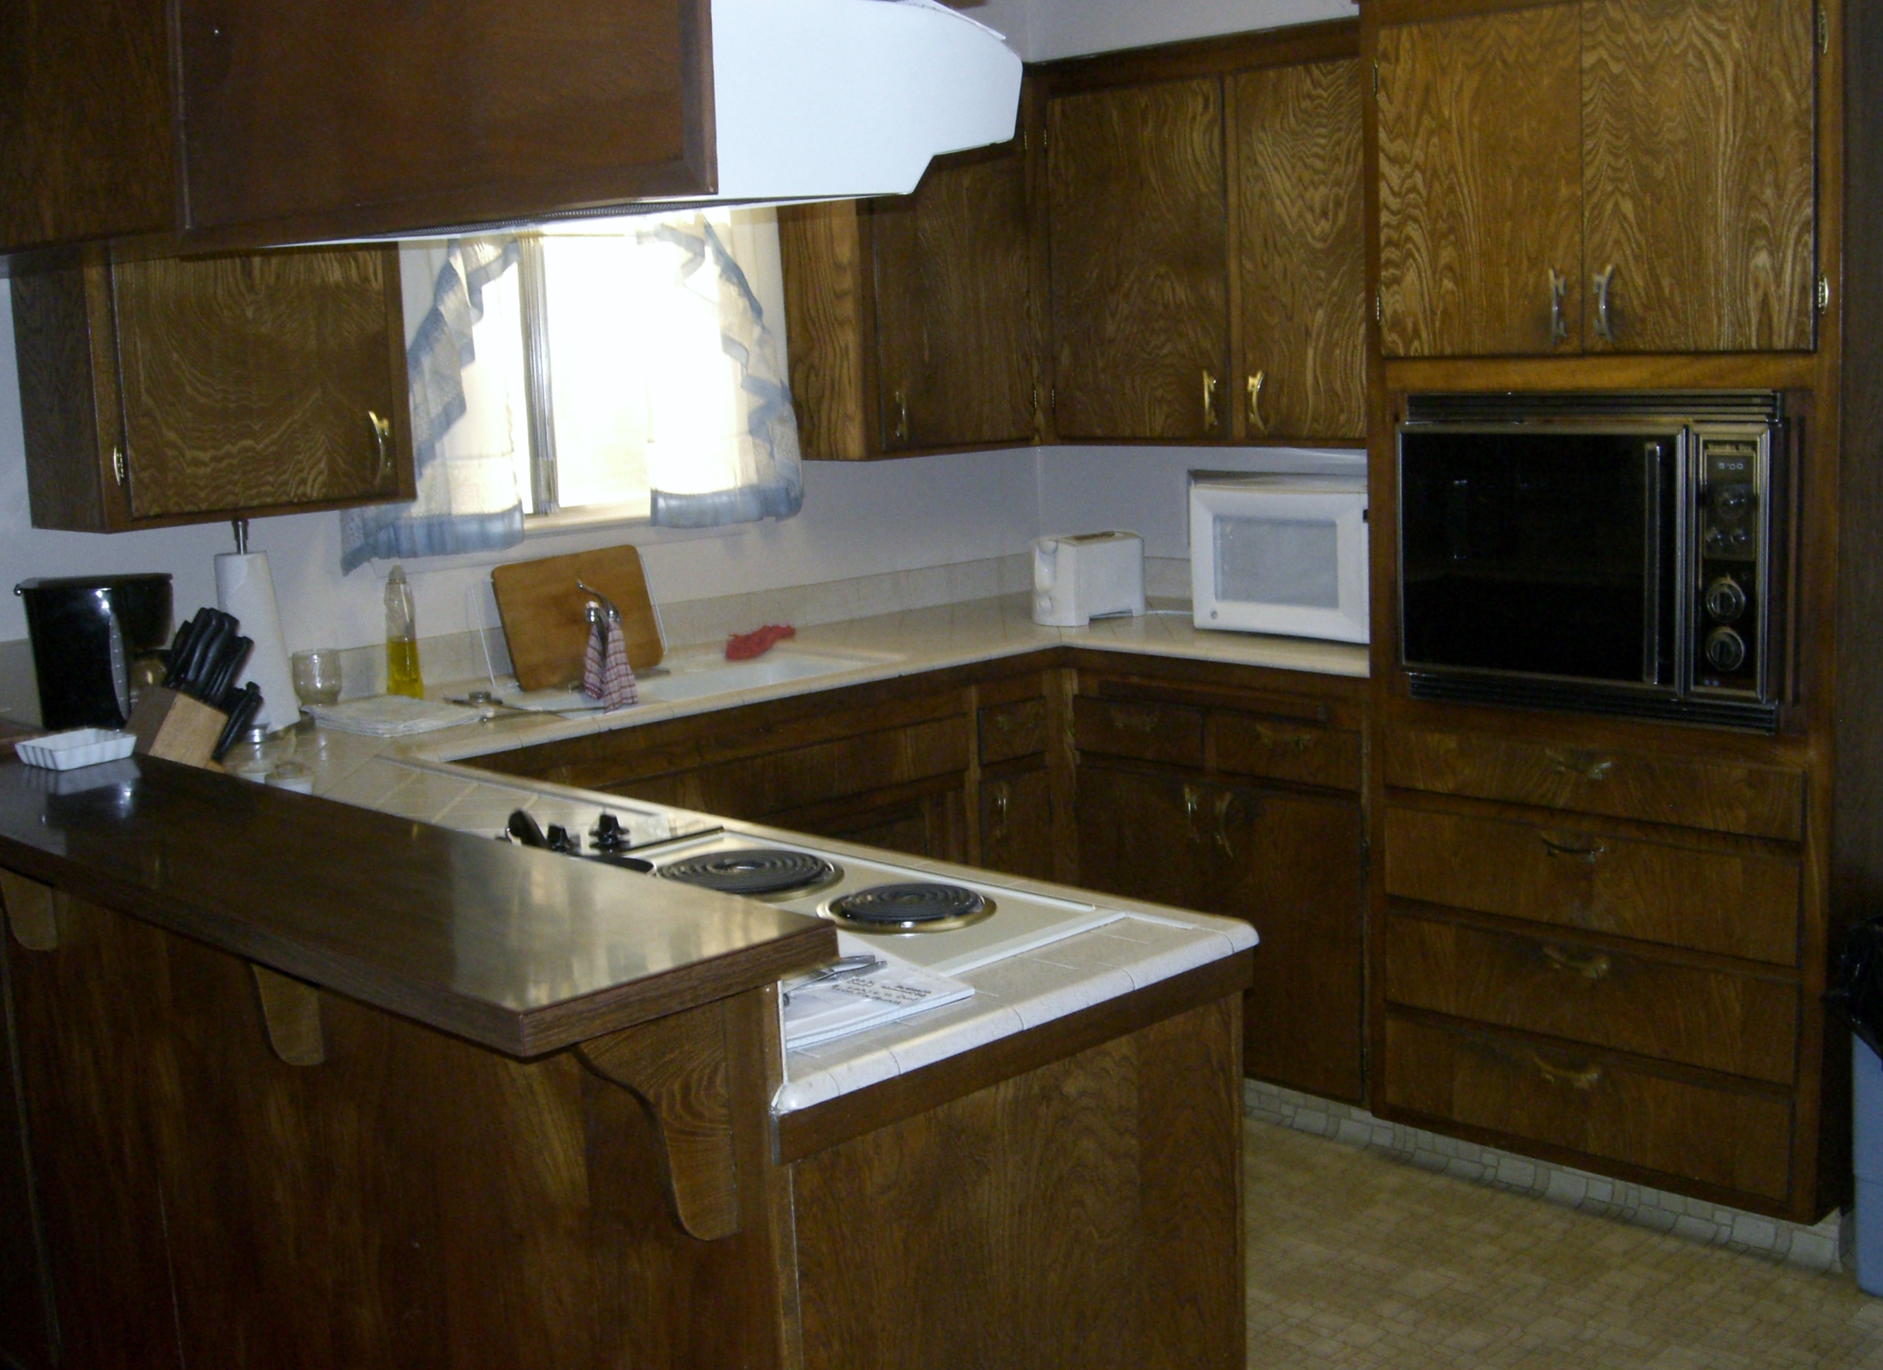
What we see

Slide 5
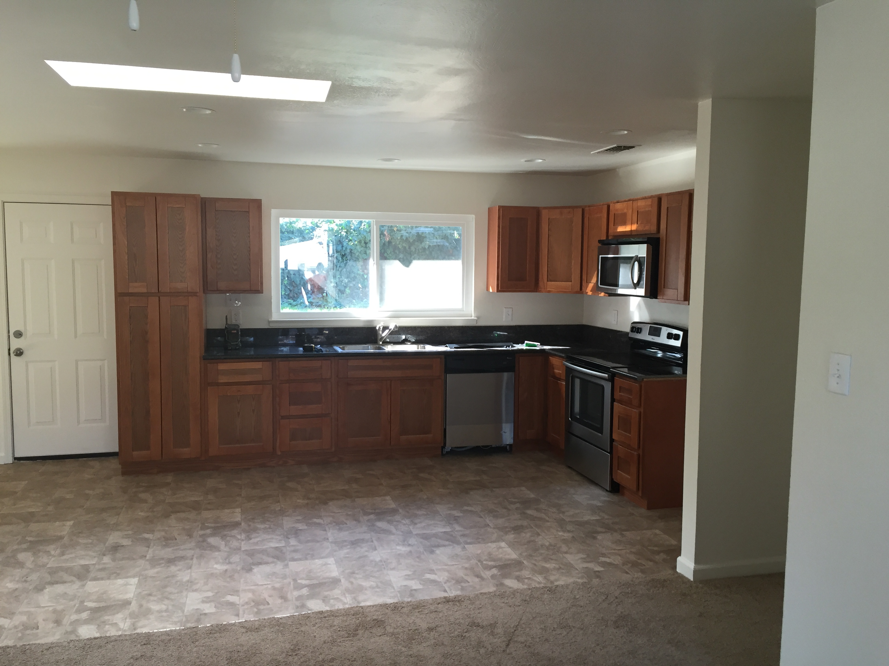
What we have to value

Slide 6
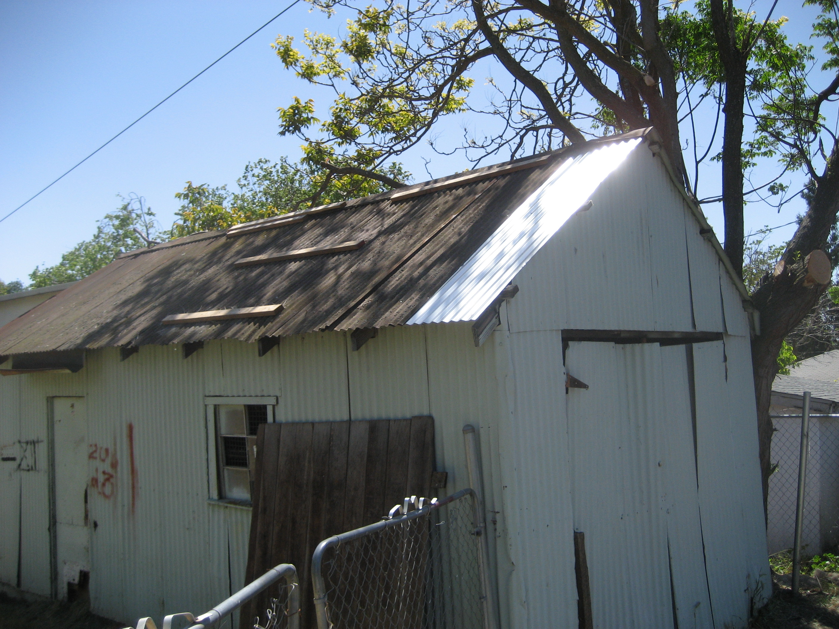
What do we do with this?
We need take something that is a negative and turn into positive. This was a shed that was ready to fall over, and had become a neighborhood nuisance.

Slide 7
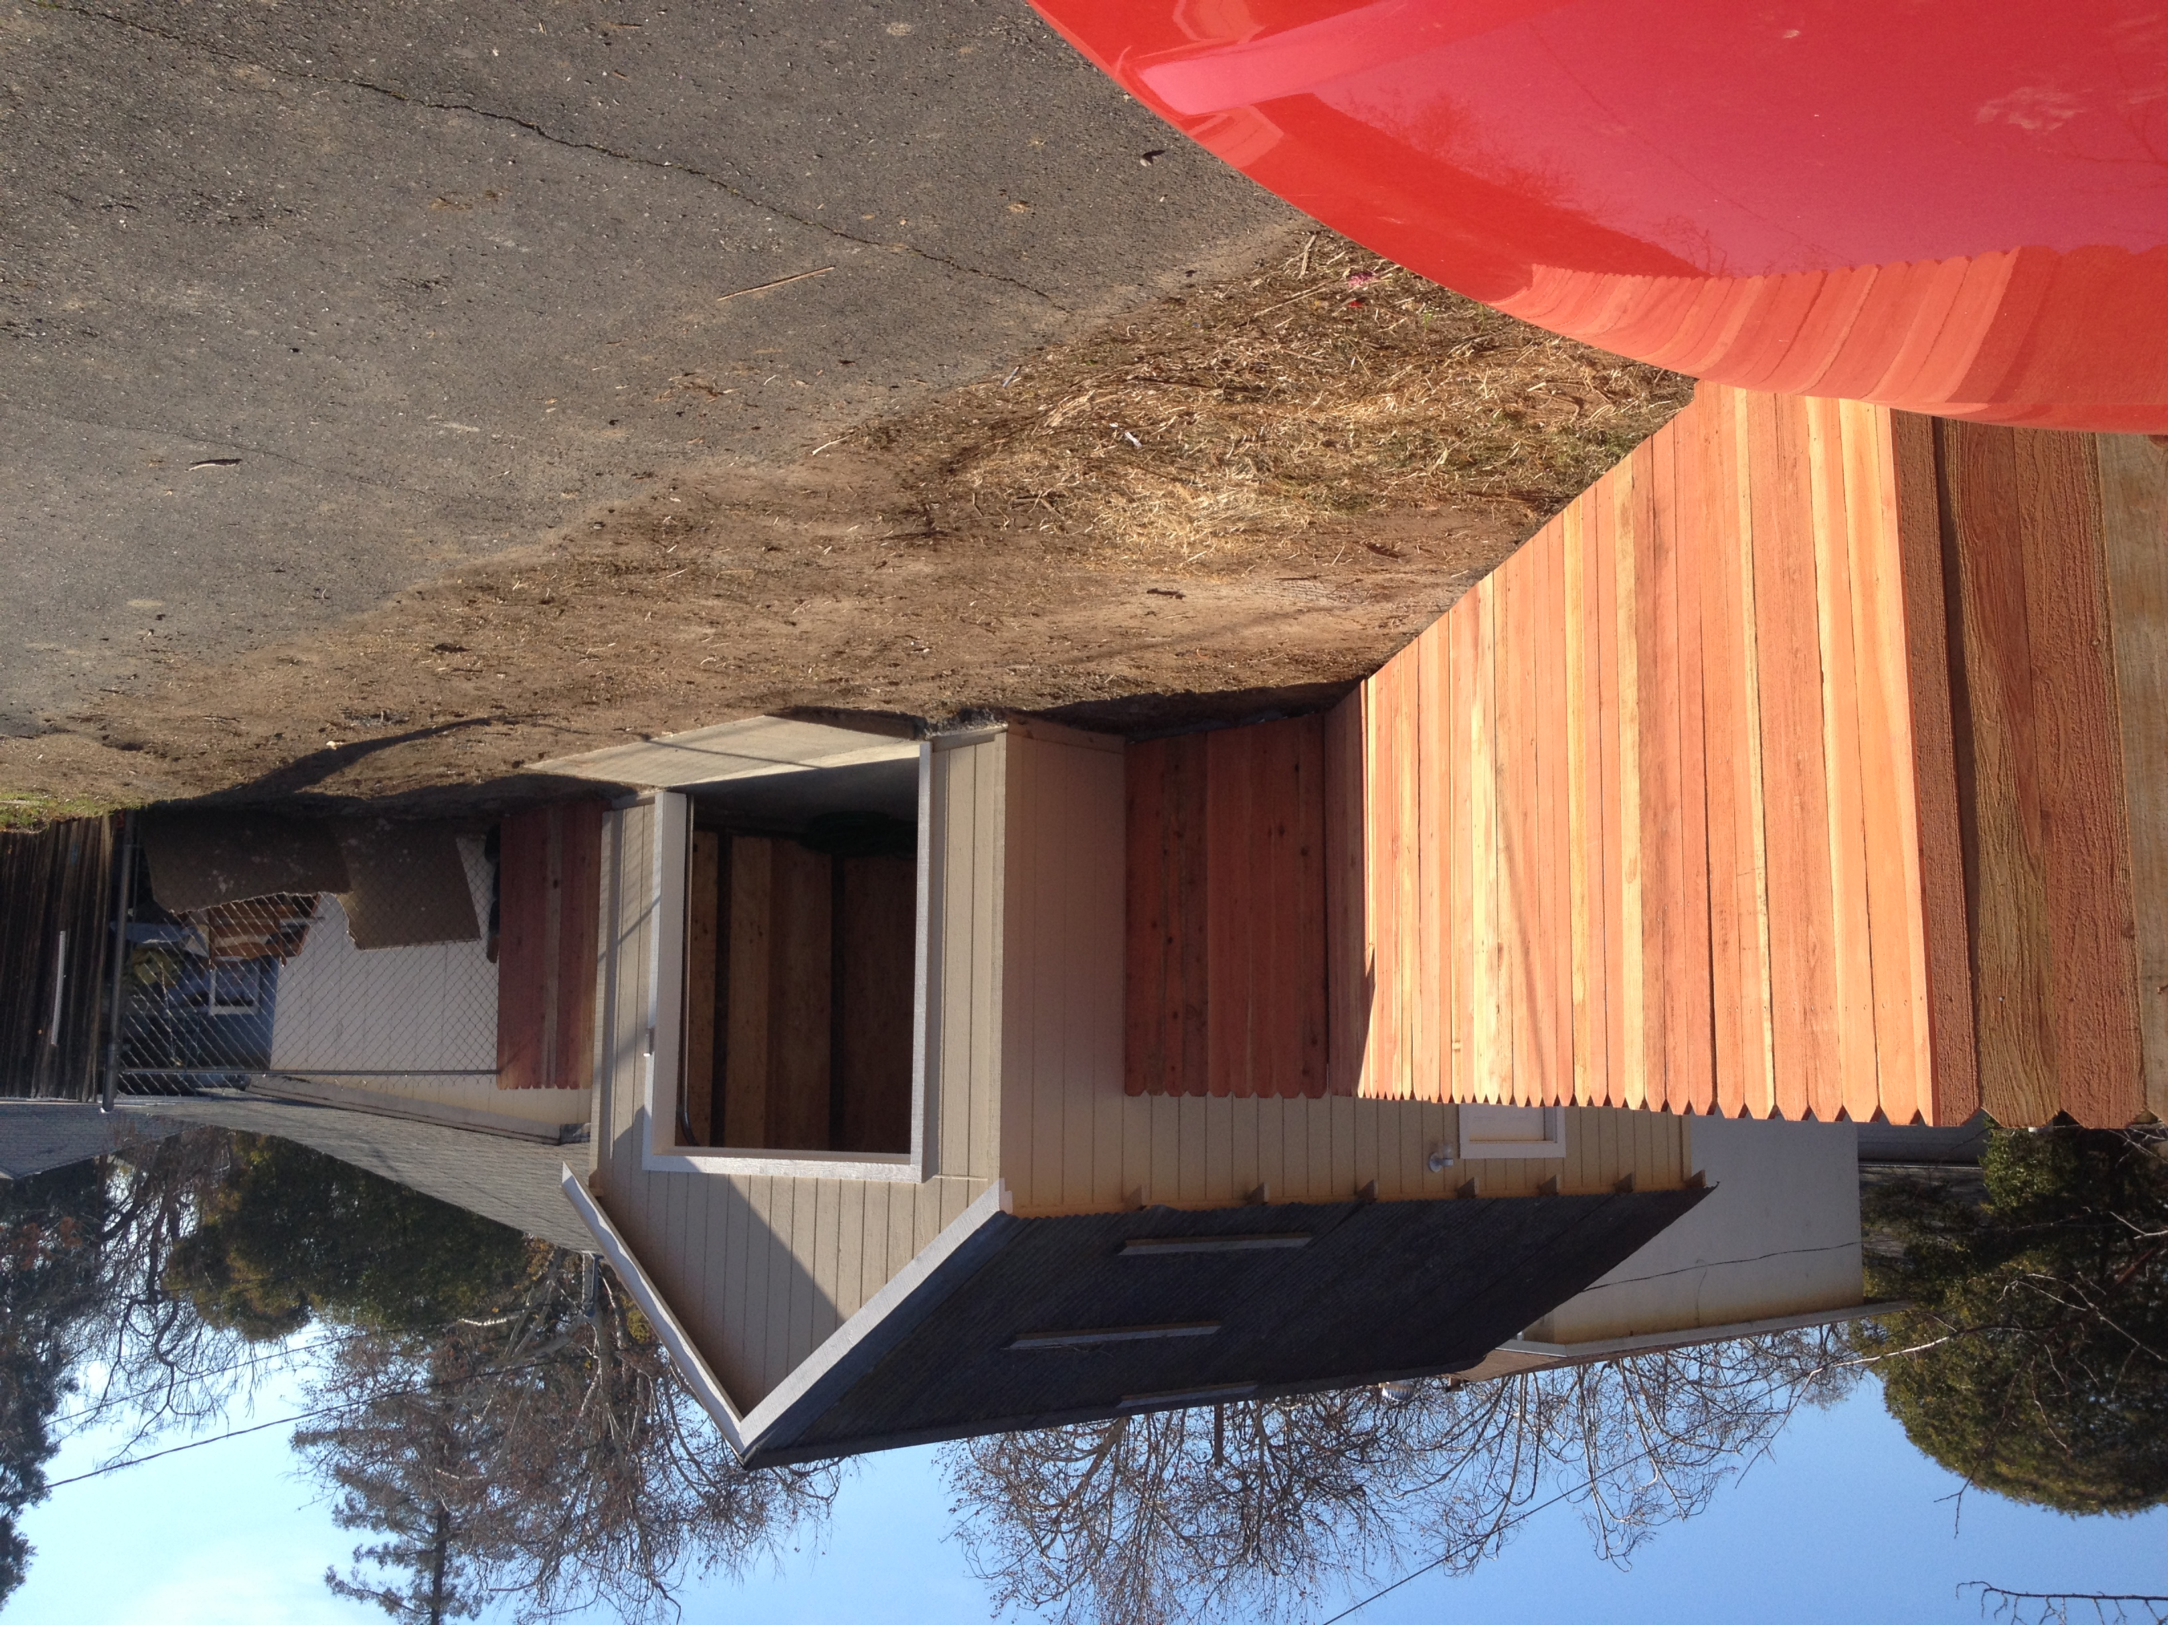
Turned into an asset not liability:
Sales pitch, detached 1 car garage with automatic opener and large fenced lot for RV

Slide 8
Formula that is used
ARV - $305K
RE fees 8% - $ 25K
Fix up/ holding cost- $ 30K
Profit - $ 35K
Purchase Price - $215K (Circled Price)
If I can get the property of for $215, I will buy it.
The formula I was taught by The Norris group ARV x .8 (.7 great) – (minus) repairs = price

Slide 9
Why is the ARV important?
The formula used to buy is based on “What will we be able to sell it for?” A.R.V.(after repair value). Very Subjective!
We walk into a property that needs work, smells, cluttered, etc. We have to have a vision. What are best things to make it worth the most, it has to be cost effective.
Good decisions come from experience. Experience comes from bad decisions.

Slide 10
How do we get ARV?
To find the ARV, I run comps in the area. I try to stay within a ¼ mile if possible. I look at the sold properties. Model Matches are great! Similar size and condition work fine.
Need to really look at the comparable.
I try to find a nice fixed up property that is similar condition, size, year, etc.
Use your best judgment to come up with ARV

Slide 11
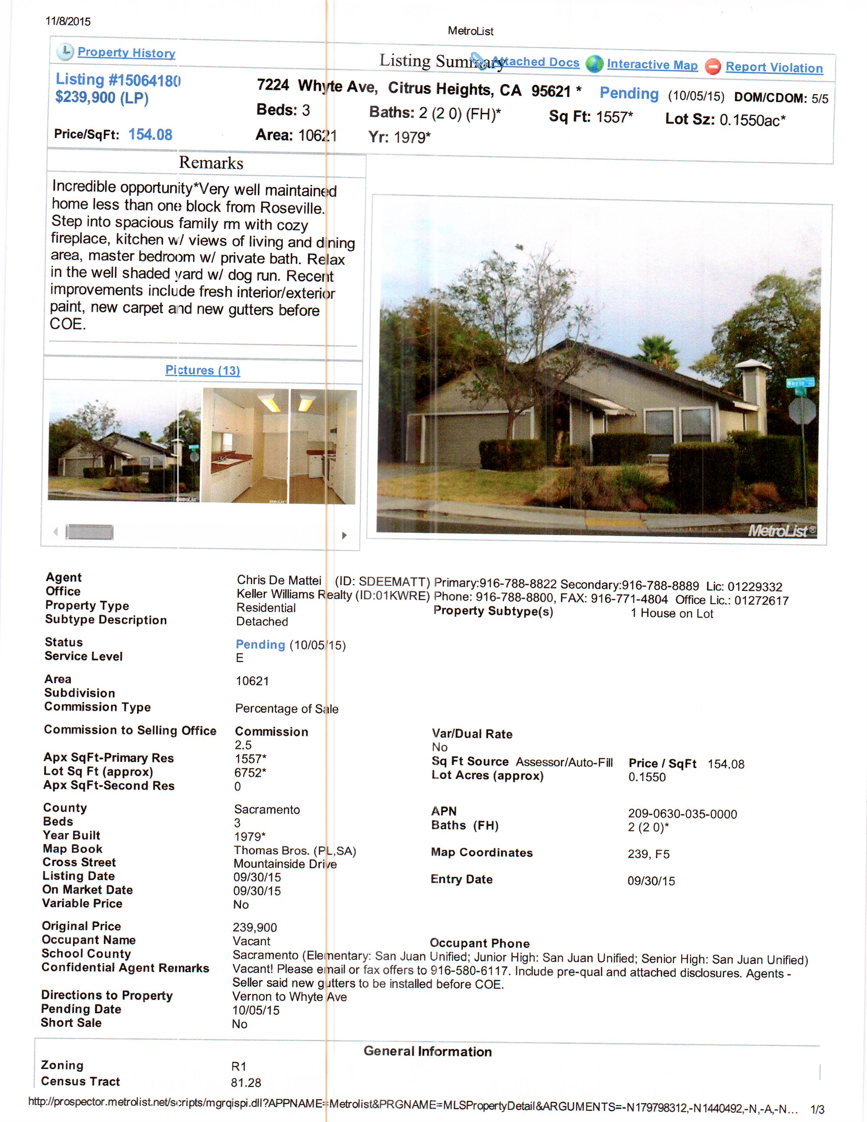
Subject Property

Slide 12
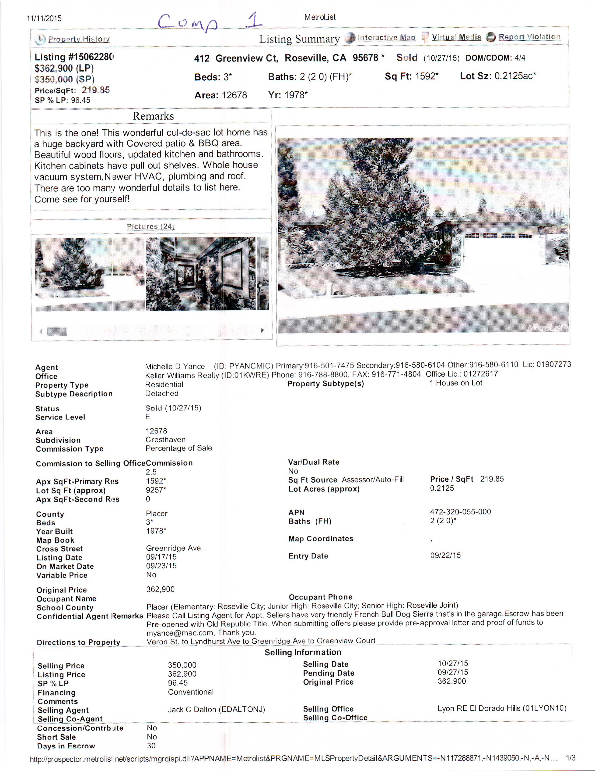
Comp 1

Slide 13
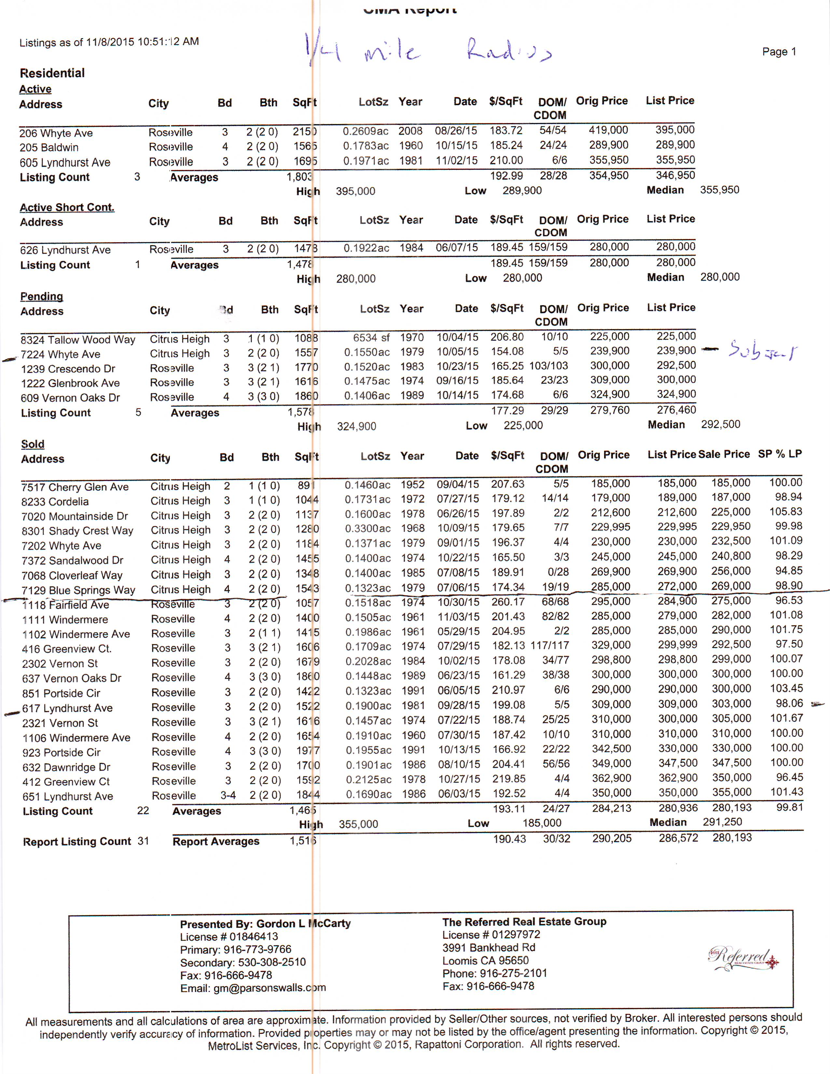
¼ mile radius comps

Slide 14
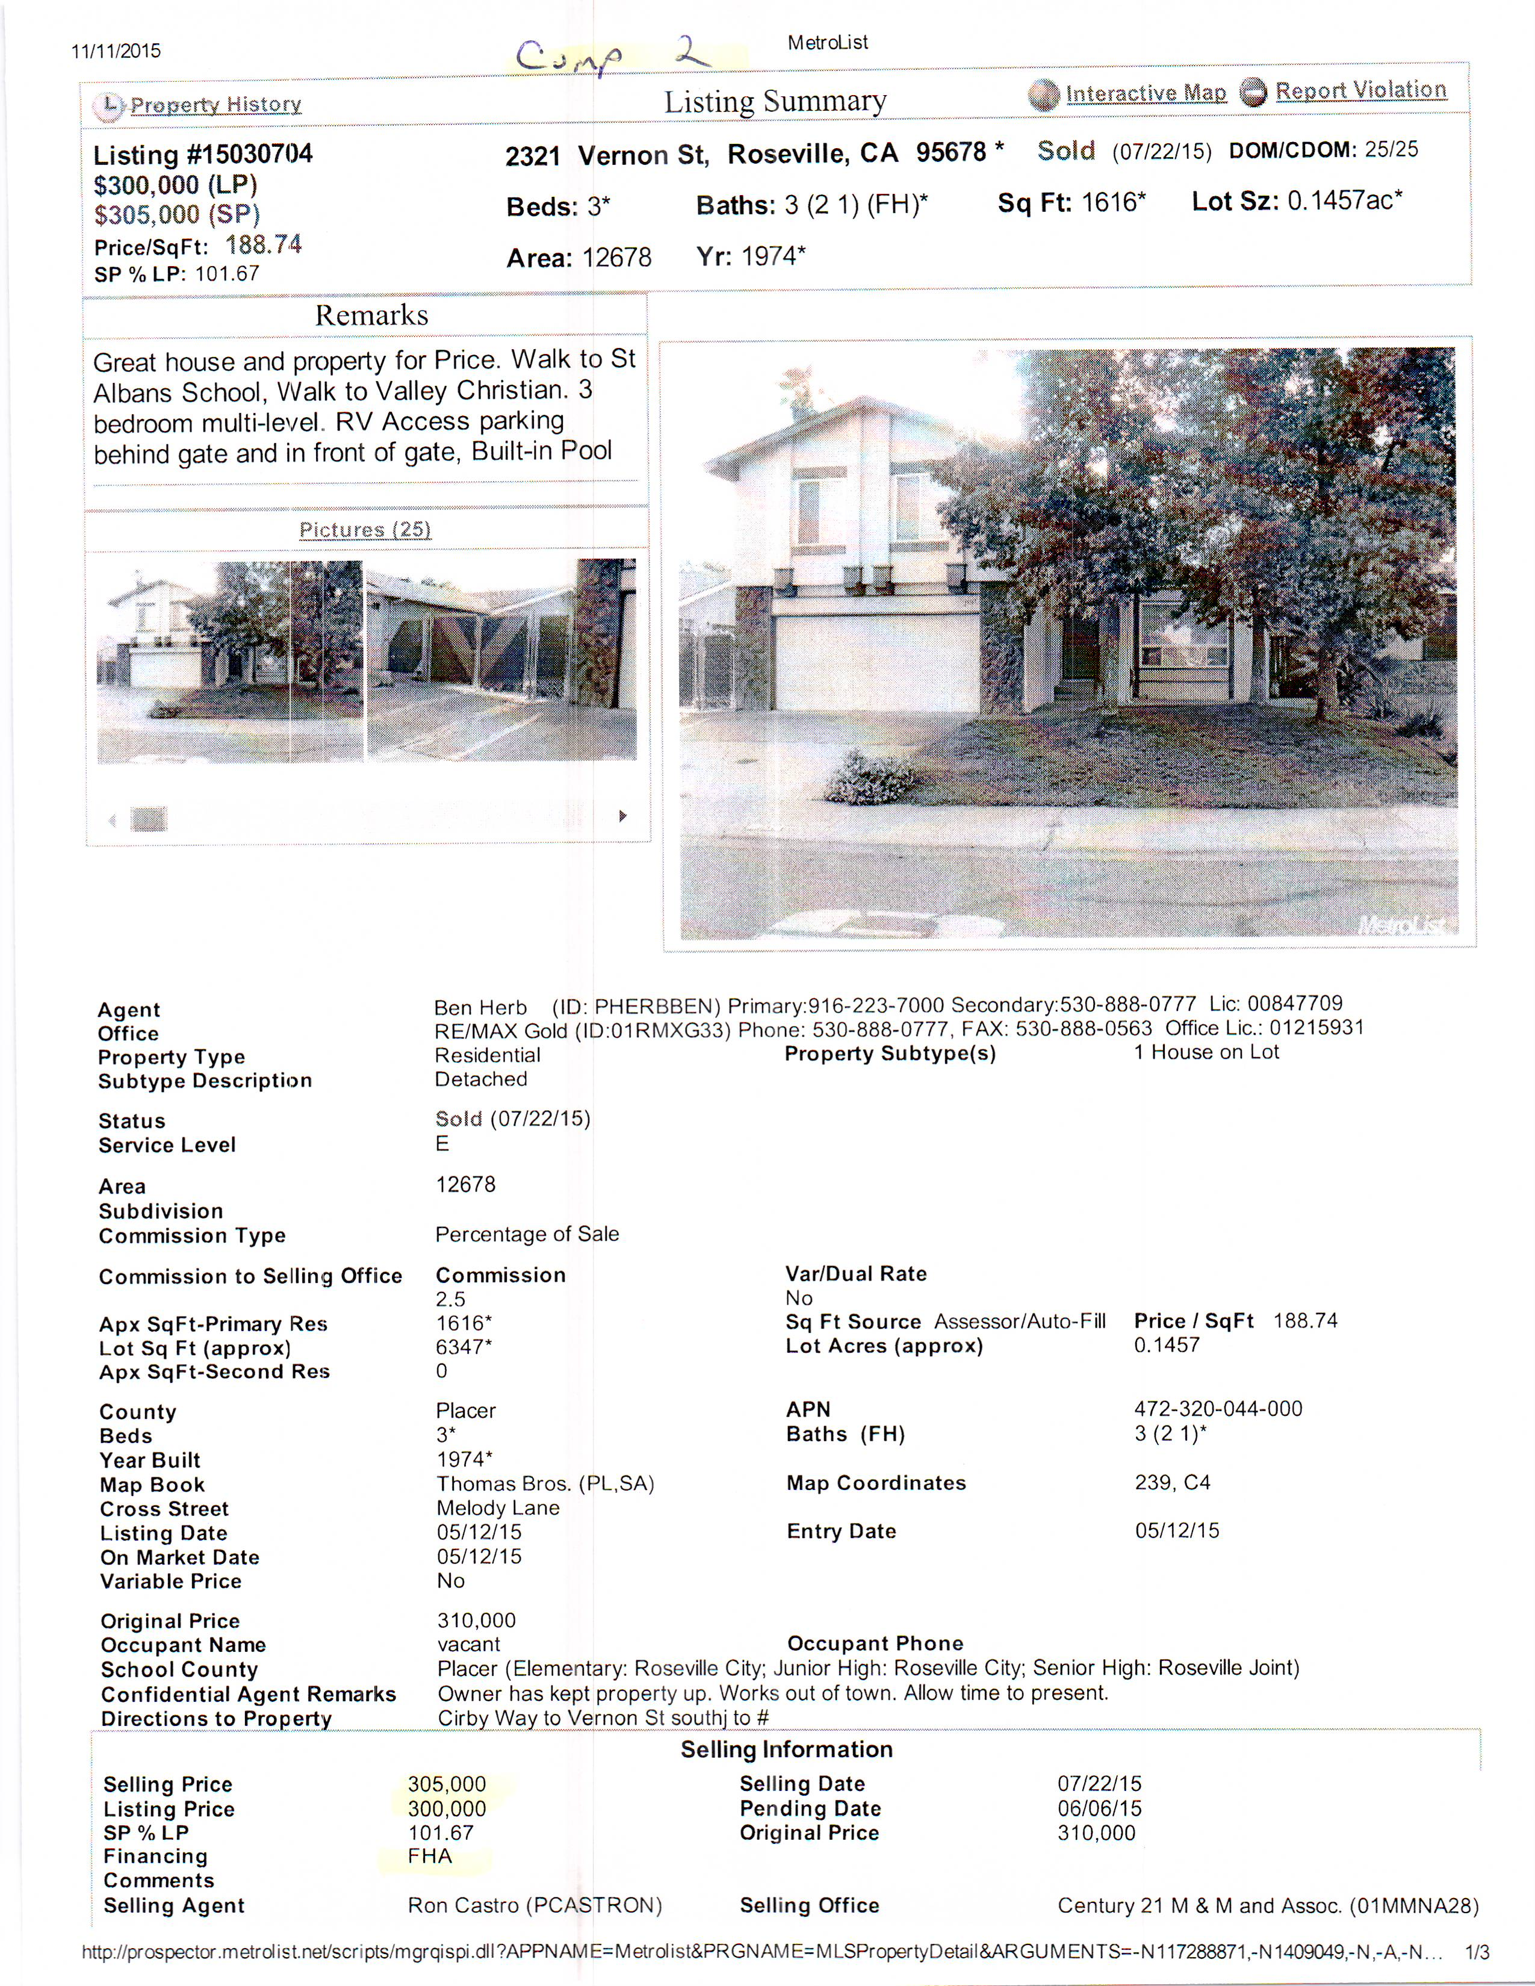
Comp 2

Slide 15
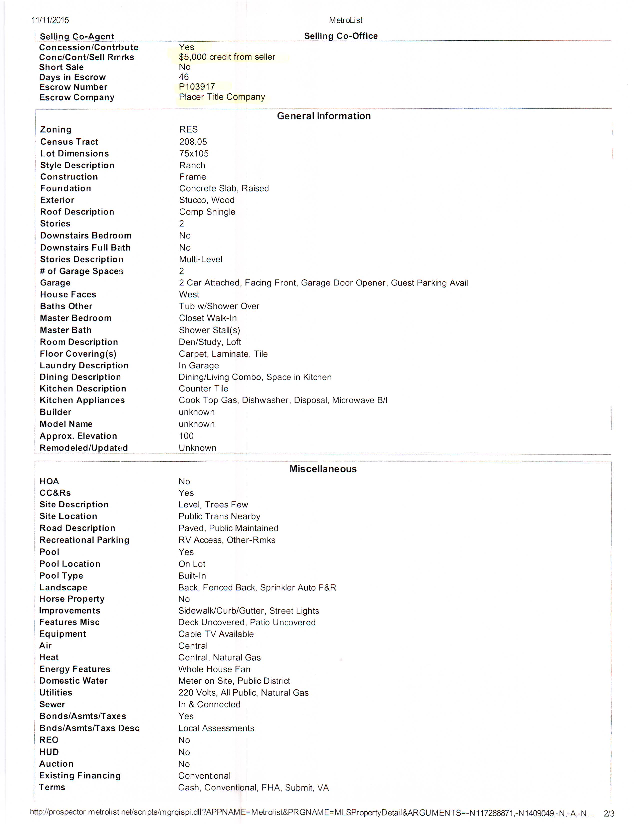
Comp 2 credit

Slide 16
Challenges deciding on ARV:
You can see large swings in value from city to city. Even if it is only one street away.
Even if a property is sold for a price, it may have had a lot of seller credits and concessions. (Comp 2)
Take your time and look at each; sold property to understand its value, understand listed properties they are the competition
Mistake on the ARV. Make sure you are realistic about the value of the property. Don’t count on prices going up when you are buying.

Slide 17
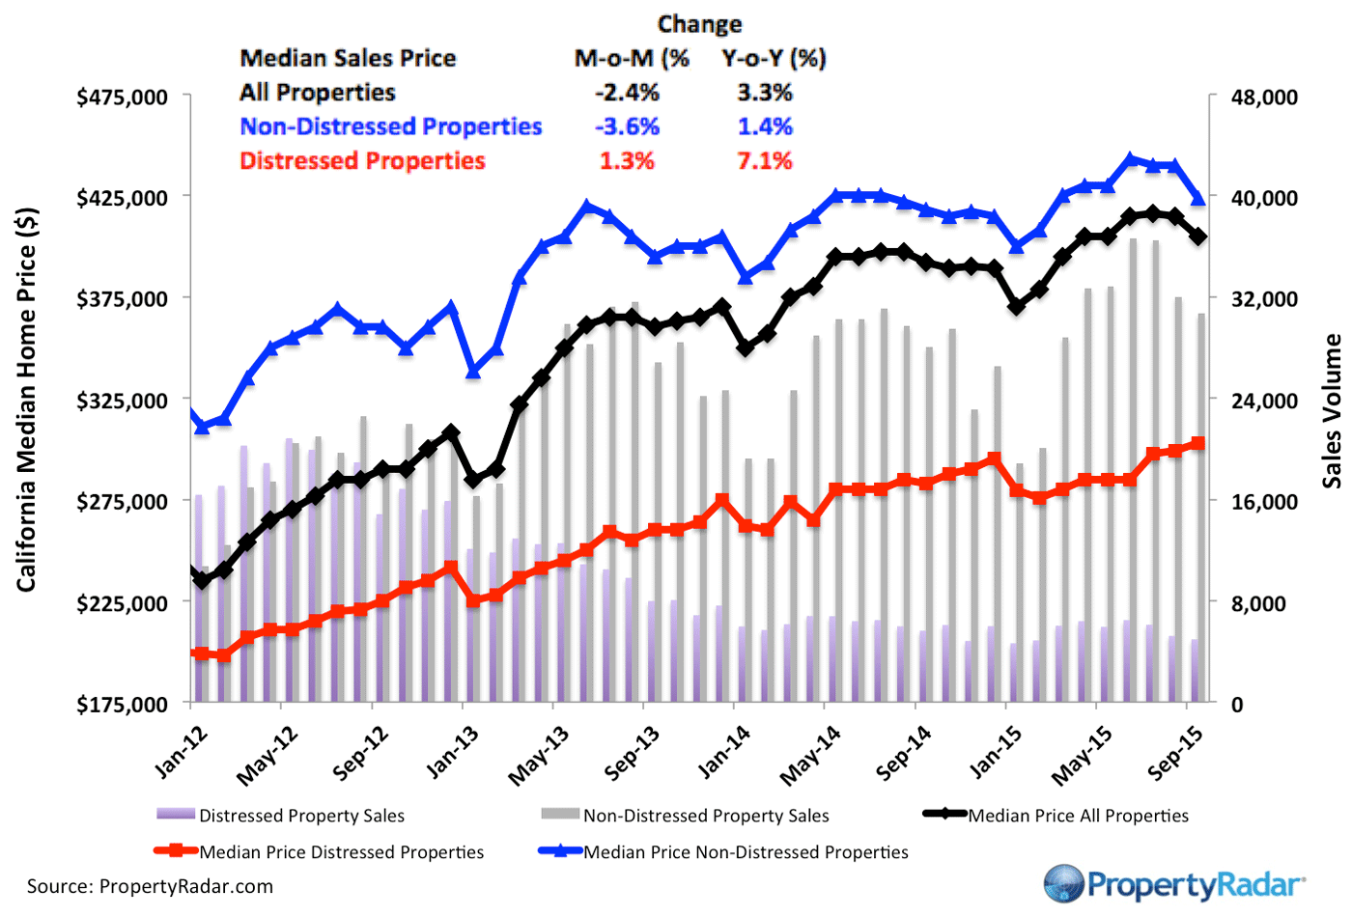
Median prices:

Slide 18
Decision Continued:
Once I have the ARV, I am ready to get a repair/fix up budget.
My formula is: ARV – RE fees(8%) – fix up costs – desired profit (15% of cash out) = what I a willing to pay for a property. (Circled price)
You can how important ARV is. It is the starting point to this method.

Slide 19
Turn over to Merton

Slide 20
If you buy the property
When you did your purchase formula, that is your fix up budget for the project. Stay on budget.
Do the required repairs first to make it financeable; roof, pest report-section 1, dry root, heat/air, etc.
Once you have it financeable, you can sell to more buyers. More buyers = higher prices.
Granite, tile, paint, carpet are discretionary items. Do those still fit in budget?

Slide 21
Things that can go wrong, try to avoid them.
Fix up costs: Did not see some required repairs when you purchased. Do required repairs first.
Know when to stop; Going to far on the fix up. Not a dream home. Always want to do more
Title Issues: Lien or extra cost. (Court house)
Market Changes: government, interest rate, other inventory, etc. Do your job quickly. Get in and out before too much can change.

Slide 22
Things have been changing fast in this market.
Next pages are a couple charts I look at.
Information from places I choose. MLS, Property Radar, Speakers, Bruce Norris, etc.
Listen and learn at REIA’s
I may not agree with everyone, but I make my own decisions based on the information I choose.

Slide 23
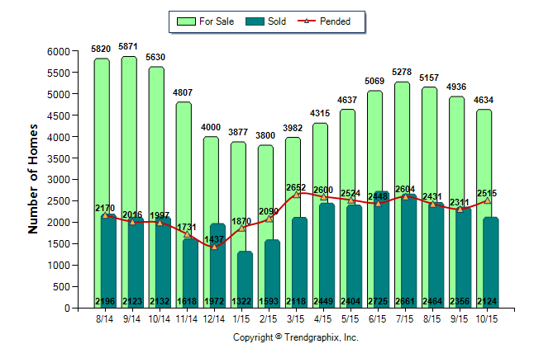
Trend Vision: Sac, Plcr, Eld. Co

Slide 24
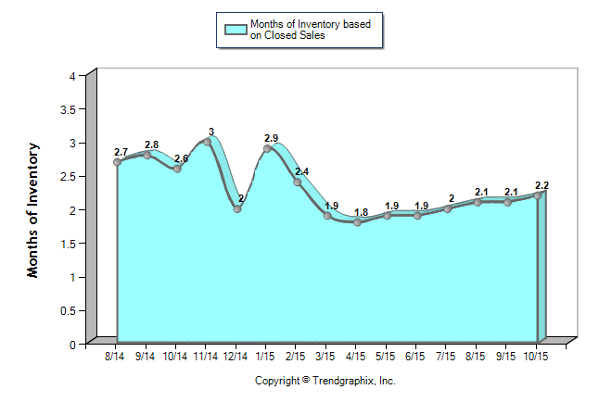
Trends from MLS – Sac. , Plcr, Eld.Co:
Months of Inventory

